Slide 1
Agenda
Slides 1-30 | 30 Minutes | 10:00
Slides 31-47 | 45 Minutes | 10:30
Break |  | 11:15
Slides 48-62 | 30 Minutes | 11:30
Slides 63-87 | 30 Minutes | 12:00
Lunch |  | 12:30
Slides 1-16 | 15 Minutes | 2:00
Slides 17-28 | 30 Minutes | 2:15
Slide 30-38 – In Class Exercise | 10 Minutes to explain 20 Minutes to test and explain Complete their drawing on the worksheet | 2:45
Break | 15 Minutes | 3:15
Slide 39-49 | 30 Minutes | 3:30
Slide 50 | 30 Minutes Share and Discuss Drawings | 4:00
Slide 78 | 30 Minutes to work on TVM and the four squares | 4:30
Close Session and Questions |  | 5:00

Slide 2
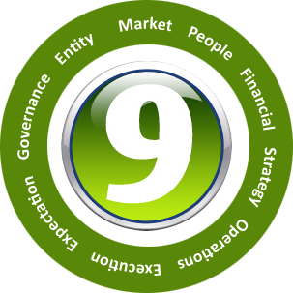
The 9Lenses™
Why the 9Lenses?
What are the 9Lenses?
Why a lens and why 9?
How are they used?
Database of Diagnostic Scenarios
Business models, content and templates
Recommendations to best of breed business models, relevant content, and templates
Web Applications
Notes:
So we have discussed what the 9Lenses are, why 9?
And how are they used?

Slide 3
To KNOW
To achieve a leadership position in any market we must invest in education, innovation, and intellectual capital.
Michael Porter and many others have written extensively on how education is the only sustainable competitive advantage.
Our workforce is global, all stages of life, with varying interest and knowledge
To be entrepreneurial, we must innovate, to innovate, we must “KNOW”.
To know we must assess and learn…

Slide 4
Driving CLARITY is Job ONE!

Slide 5
CLARITY
What is clarity?
Why do we need it?
What happens when we design a strategy without having it?
How do we measure the results of our execution without it?
What do we train or communicate about without it?

Slide 6
Fostering ENTHUSIAM, COLLECTIVE LEARNING, & TEAM is Job TWO!

Slide 7
COLLECTIVE LEARNING
When people learn together, they stay together, they are connected
This drives TEAM and teamwork
As the TEAM learns they see more clearly
Two heads are better than one!

Slide 8
Creating ALIGNMENT is Job THREE!

Slide 9
ALIGNMENT
Once we see, and have a TEAM that is learning together, we can strive for Alignment
This does NOT mean we are going the right direction
It only means we are aligned and able to row in the same direction

Slide 10
Devising INTELLIGENT & MEASURABLE Strategy is Job FOUR!

Slide 11
STRATEGY
We don’t just want a strategy
We want a strategy that makes good sense and can be measured

Slide 12
Creating ACCOUNTABILITY, OWNERSHIP, & EMPOWERMENT is Job FIVE!

Slide 13
OWNERSHIP
We want all stakeholders to feel like owners.
Ownership drives responsibility and accountability.
Would we rather have employees that think in terms of “OPM” – “other people’s money” – or in terms of owners?

Slide 14
Objectives of the FOCUSED Leader!
Drive CLARITY!
Foster COLLECTIVE LEARNING, ENTHUSIAM, TEAM!
Create ALIGNMENT!
Devise INTELLIGENT & MEASURABLE STRATEGY!
Create ACCOUNTABILITY, OWNERSHIP, & EMPOWERMENT!

Slide 15
BUT WE TEND TO:
Not know what we don’t know
Work in our areas of comfort
Focus on, correct, align what we see
Appreciate what we do – but not what others are or are not doing…

Slide 16
WORSE YET…
Most companies don't know what they don't know
Many of us nod up and down – ESPECIALLY when we don't understand
Most people follow the conversation versus creating intelligent conversations
They fail to probe and unearth the real business problems we face (symptoms driven)

Slide 17

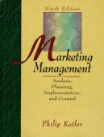
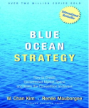
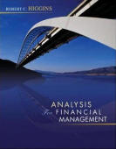



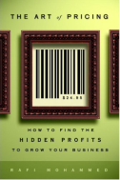

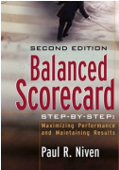

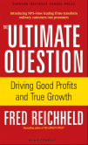
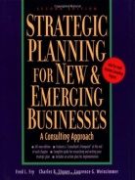





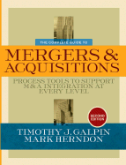
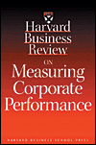
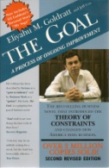
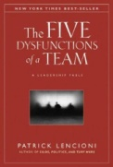
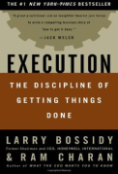
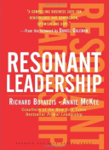
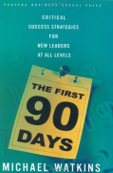
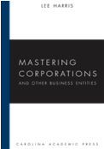

Further!

Slide 18
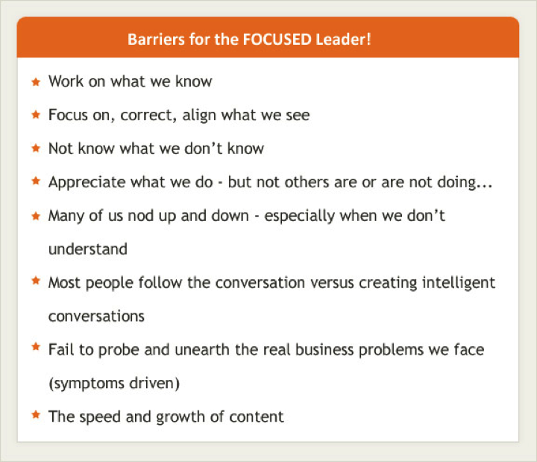

Slide 19
Barriers for the FOCUSED Leader!
Not know what we don’t know
Work in our areas of comfort
Focus on, correct, align what we see
Appreciate what we do – but not what others are or are not doing…
Many of us nod up and down – ESPECIALLY when we don't understand
Most people follow the conversation versus creating intelligent conversations
Fail to probe and unearth the real business problems we face (symptoms driven)
The speed and growth of content

Slide 20
ULTIMATELY…
People are rowing and they don't understand the water, boat, etc.
A SAILING SCENARIO…

Slide 21
Global Governance Concerns
Span of control
Increasing stovepipes
Lack of strategic oversight
All have become challenges to ensuring effectiveness in our systems…

Slide 22
WHY THE 9LENSES™ - ACADEMIA…

Slide 23
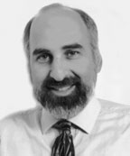
MIT Sloan School
System dynamics simulation model
Largest issue for boom and bust cycles is “supply and demand”
Three buffers against supply and demand issues:
Current inventory or capacity
Immediate production or hiring
Long-term capacity
All three with structured feedback loops
Differing speeds of adjustment
John Sterman
Notes:
System dynamics simulation model to produce simple commodity market cycles
Postulates that the largest issue for boom and bust cycles is “supply and demand”
Three critical buffers against supply and demand mismatches:
You have an inventory of widgets
Immediate production of more widgets
Amount of long-term capacity
Sterman’s model had all three with structured feedback loops with differing speeds of adjustment

Slide 24

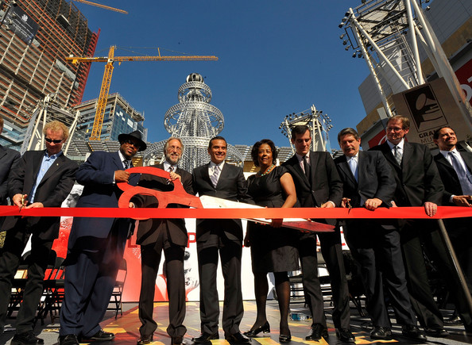
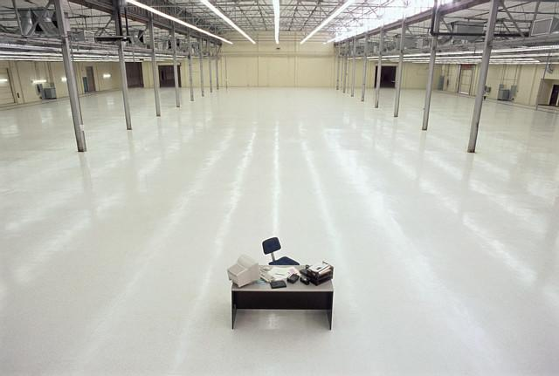
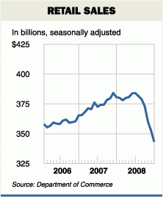
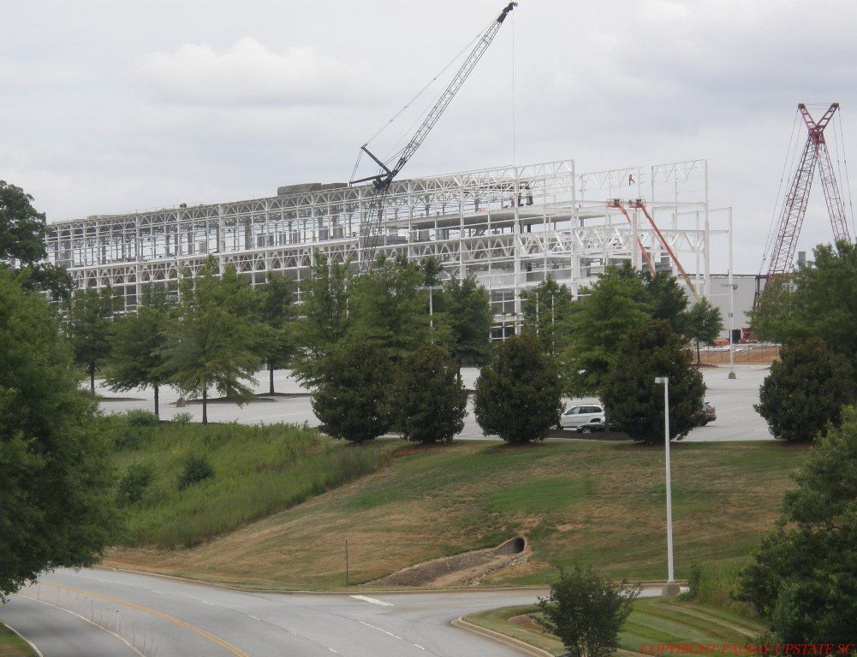
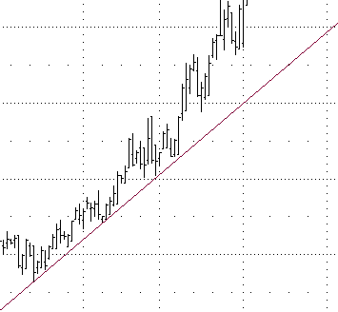

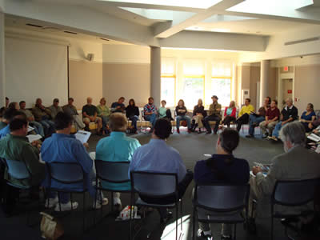

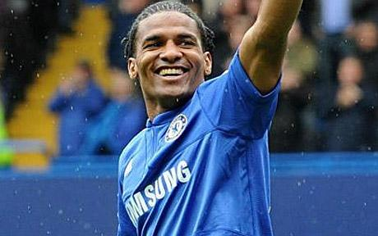


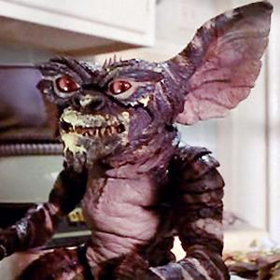
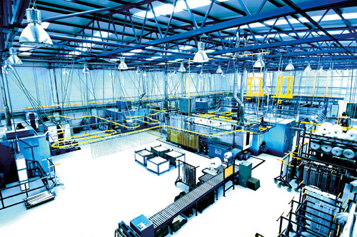
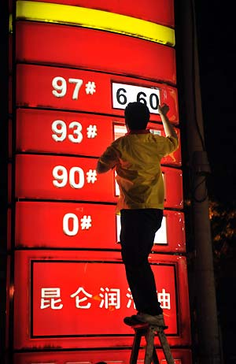
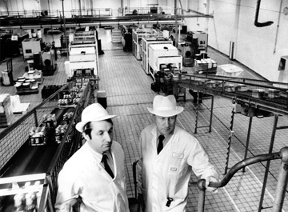
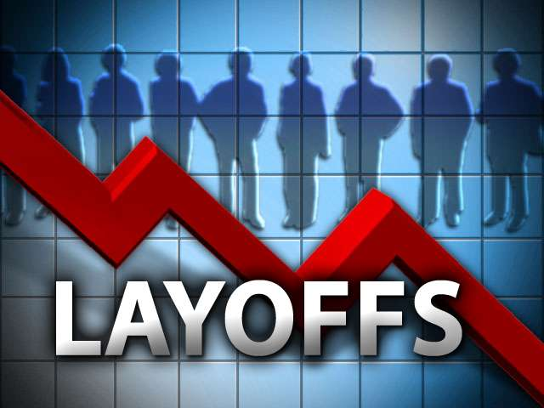
Why the 9Lenses?
We are business managers…
We sell products – such as a widget – or people delivering services
Notes:
To see how this played out – imagine you are a manager of the widget product line…
You get a weekly product report, you sit and read the report and realize that demand has a nice uptick and inventories have dropped a bit
There are random decreases or increases all the time, so the first thing you consider is to ask the factory for an increase in production...
A natural reaction to this would be to wait just a little while to see if the rise will persist or if it is a blip…
The next question to consider would be, “should I raise the prices of the product? But you know that if you raise prices that is systemic change through the entire company.
In the next inventory report, the rise in demand has continued and you now believe there is a definite trend.
Inventories have dipped dangerously low and there are customers on back order.
Now you jump into action and put in a request to increase production.
Corporate grinds through the bureaucracy, the factory takes some time to make the adjustments, and it not until several weeks later that the production actually increases. In the meantime, demand has continue to rise, but now there are stock outs and order backlogs as customer have exhausted your inventory…
Given the robust demand and product shortages, you now reach the conclusion to also raise prices.
The price increase does not immediately impact demand given the shortages AND they cannot immediately find substitutes for your product in the market.

Slide 25
MIT Sloan School
MIT / Sterman’s Finding:
Our minds cannot comprehend and are not wired for non-linear decisions…
John Sterman
Notes:
System dynamics simulation model to produce simple commodity market cycles
Postulates that the largest issue for boom and bust cycles is “supply and demand”
Three critical buffers against supply and demand mismatches:
You have an inventory of widgets
Immediate production of more widgets
Amount of long-term capacity
Sterman’s model had all three with structured feedback loops with differing speeds of adjustment

Slide 26
Columbia University
Jon Elster a behavioral economist
Extensive research on behavioral biases
Five areas where we struggle with biases…
Notes:
Framing Biases – Exactly how and issue is framed can affect how think about it.
Representativeness – People have a bad habit of drawing big conclusions from very small and biased samples
Availability biases – People tend to make decisions based on data that is easily available as opposed to finding the data that is really needed to make a good decision
Difficulties in judging risk – Most people have a tough time reasoning with probabilities and assessing risks
Superstitious reasoning – We often confuse random chance with cause and effect

Slide 27
Columbia University
FRAMING BIASES
REPRESENTATIVENESS
AVAILABILITY BIASES
DIFFICULTY IN JUDGING RISK
SUPERSTITIOUS REASONING
Notes:
Framing Biases – Exactly how and issue is framed can affect how think about it.
Representativeness – People have a bad habit of drawing big conclusions from very small and biased samples
Availability biases – People tend to make decisions based on data that is easily available as opposed to finding the data that is really needed to make a good decision
Difficulties in judging risk – Most people have a tough time reasoning with probabilities and assessing risks
Superstitious reasoning – We often confuse random chance with cause and effect

Slide 28
Columbia University
His Findings:
Only the clinically depressed can make unbiased cognitive assessments
Notes:
Framing Biases – Exactly how and issue is framed can affect how think about it.
Representativeness – People have a bad habit of drawing big conclusions from very small and biased samples
Availability biases – People tend to make decisions based on data that is easily available as opposed to finding the data that is really needed to make a good decision
Difficulties in judging risk – Most people have a tough time reasoning with probabilities and assessing risks
Superstitious reasoning – We often confuse random chance with cause and effect

Slide 29
WHY THE 9LENSES™ - MOUNTING COMPLEXITY…

Slide 30
Mounting Complexity
David Snyder, futurist and author
Created a concept called: complexipacity
A person or organization’s threshold for assimilating or addressing complex idea, systems, problems, situations, interactions, etc…
Content from Wiener, Edrich, Brown, Inc.

Slide 31
Mounting Complexity
The Santa Fe Institute revisited complexity
Attempted to establish a universally accepted definition of the word, and universally accepted measures of complexity
There were 67 delegates to the session
Content from Wiener, Edrich, Brown, Inc.

Slide 32
Mounting Complexity
The end result was 67 different definitions and sets of measures
Content from Wiener, Edrich, Brown, Inc.

Slide 33
Mounting Complexity
In 2009, the MIT Sloan School initiated a new Masters program in finance because the field had become too complex for the standard MBA
Complexity is requiring more specialized knowledge, but how do we connect the knowledge?
How do we stay at 30,000 feet AND know that things at 1,000 feet are connected and working?
Content from Wiener, Edrich, Brown, Inc.

Slide 34
Complicated versus Complex
COMPLICATED
COMPLEX
Closed system
Linear
Fixed elements
Constrained dynamics
(example: the internal combustion engine)
Open system
Non-linear
Unconstrained dynamics that are subject to externalities which can cause rapid transformational change or chaos;
They are stable and coherent only as long as their multiple components are in equilibrium
Cannot be predicted with reliability: they involve infinite numbers of variables, links and feedback loops; risk is certain
If human factors are in any way involved the risks become more uncertain
They are subject to emergence (novelties which cause mutations) and infinite ambiguity
Content from Wiener, Edrich, Brown, Inc.

Slide 35
Collaboration is REQUIRED
The approaches to complex systems and issues will not be successful if in silos
Whether within an organization or across organizations (and even geographic entities), collaboration will continue rise in importance
But what should be the focus of the collaboration?

Slide 36
Back to JOB ONE!
To collaborate in a productive manner, there must be CLARITY around the topic being discussed

Slide 37
WHY THE 9LENSES™ - PRACTICAL…

Slide 38

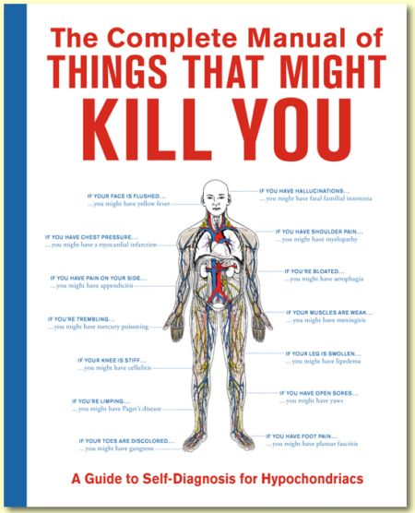
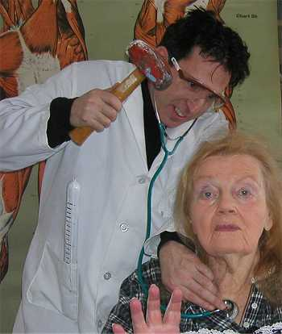
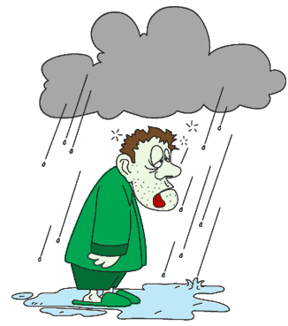
Why the 9Lenses™?
Notes:
Let’s look at the Lenses through an analogy…
Let’s say for a moment that we are feeling a little under the weather. A bit tired, just not ourselves…
What do we do?, we simply self diagnose. We have felt this way before. This is the same as last time. So we focus on what we already know, our past experiences now are in full effect, they are driving our future experience. We live in our own four walls. Now, if there is not a systemic issue, that works out just fine, but if we have not had an annual and comprehensive checkup on ourselves in many years, and we self diagnose, it could be something worse.
The same thing happens in business, let’s say we see sales flattening out.
What is a normal scenario for us, void any full cohesive and comprehensive business analysis that is very simple to complete? Well, the head of sales gets a sit down by the CEO. Maybe the CFO is in the room, but certainly the CFO was part of this analysis at some point. Likely, the CFO was asked by the CEO, how are things looking this month. And given all of our systems are connected and fully interactive / real time, the CFO simply pushes a few buttons and voila, the answer appears. Sales are flat.. Now back to the conversation with the CEO and the head of sales. What does the head of sales say? They say, we don’t have enough leads, or the product is not as good as the competitors, or something similar. We have all heard these same symptoms… just like we have all had those same body aches in the past. So what do we do? We decide have a sit down the head of marketing and the head of sales and they create a new sales and marketing campaign OR better yet, many times we actually hire an outside firm to assess how to improve our brand or sales growth through attracting more good leads, you know the Glen Gary leads… Now, we spend more. As the CFO, you sit and agree to ramp spend and sales people, against your gut feeling and better judgment, and we are three months down the road. Did it work? How do we know? It could have worked, but it may be nothing that we did. It could have just been market timing. It could have been because a competitor really stepped in it... But let us assume for a moment that this did not work. What did we do up that point? We told the board our action plan to increase leads and sales… We talked to the employees about what we are going to do to grow… But none of it worked. We have just harmed our expectations lens… Just like in real life, if we self diagnose and are wrong, if we do not have a complete picture that is continuous, we may be right, but we may be wrong…
So lets stay with the analogy… We are sick, we don’t improve and then we go to our neighbor or a friend that knows a Doctor… They have some new books they read that are very good and it suggest we take an IV every day for three weeks. Now at the end of this three weeks, are are not any better… In fact, we are worse and our spouse is calling us bull headed and stubborn for not just going to the doctor to understand what is wrong. Finally, we agree, we need a doctor, so we set an appointment with the Doctor. How do you choose the right doctor? Well, we have a cousin that is a Doctor, a distant cousin…
We are sick, we need help. It could turn out fine, but it may take a while. It could be an easy correction and we are disbelief we spent that much time dealing with the symptoms. OR, it could be a very bad illness that we should have dealt with immediately…
So in the business world, it really is not different, but where is the system that allows objective diagnosis? Where is the system that allows a comprehensive and cohesive view of our business BUT does not require an army of consultants to write a 1000 page report with really big words and tell us what we already knew about our business. That is exactly what the (9)Lenses offer.
It is a meeting with the general practitioner, that provides the comprehensive and hopefully recurring assessments, that leads us to the right specialist, that can solve the issues that could become systemic. Sometimes the issues are solvable, but knowing what they are could allow us to change our environment to alleviate the symptoms. We could launch a new product and sunset a product line that was in a very tough and dying market…
The (9)Lenses provides the ability to diagnose based on a holistic perspective, remedy or act on the issue with intelligence and in a concerted effort, and then continue to monitor the improvement.

Slide 39
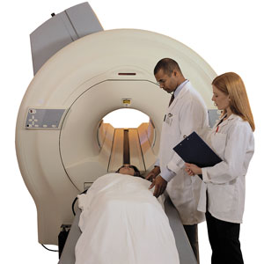

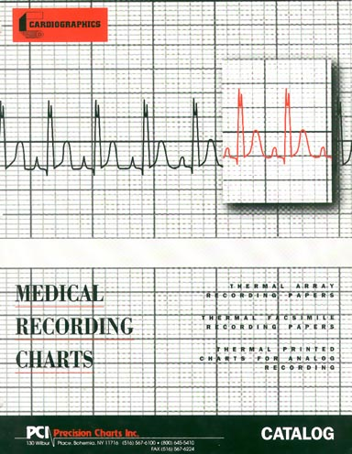
The 9Lenses™
Effective Diagnosis
Complete Perspective
Continuous
Measurement
Tendency to self-diagnose
Live in our own four walls
Focus on perceptions and past experiences
Shift capacity to gain a full picture, then act
Notes:
Let’s say for a moment that we are feeling a little under the weather. A bit tired, just not ourselves… what do we do, we simply self diagnose. We have felt this way before. This is the same as last time. So we focus on what we already know, our past experiences now are in full effect, they are driving our future experience. We live in our own four walls. Now, if there is not a systemic issue, that works out just fine, but if we have not had an annual and comprehensive checkup on ourselves in many years, and we self diagnose, it could be something worse.
The same thing happens in business, let’s say we see sales flattening out. What is a normal scenario for us, void any full cohesive and comprehensive business analysis that is very simple to complete? Well, the head of sales gets a sit down by the CEO. Maybe the CFO is in the room, but certainly the CFO was part of this analysis at some point. Likely, the CFO was asked by the CEO, how are things looking this month. And given all of our systems are connected and fully interactive / real time, the CFO simply pushes a few buttons and voila, the answer appears. Sales are flat.. Now back to the conversation with the CEO and the head of sales. What does the head of sales say? They say, we don’t have enough leads, or the product is not as good as the competitors, or something similar. We have all heard these same symptoms… just like we have all had those same body aches in the past. So what do we do? We decide have a sit down the head of marketing and the head of sales and they create a new sales and marketing campaign OR better yet, many times we actually hire an outside firm to assess how to improve our brand or sales growth through attracting more good leads, you know the Glen Gary leads… Now, we spend more. As the CFO, you sit and agree to ramp spend and sales people, against your gut feeling and better judgment, and we are three months down the road. Did it work? How do we know? It could have worked, but it may be nothing that we did. It could have just been market timing. It could have been because a competitor really stepped in it... But let us assume for a moment that this did not work. What did we do up that point? We told the board our action plan to increase leads and sales… We talked to the employees about what we are going to do to grow… But none of it worked. We have just harmed our expectations lens… Just like in real life, if we self diagnose and are wrong, if we do not have a complete picture that is continuous, we may be right, but we may be wrong…
So lets stay with the analogy… We are sick, we don’t improve and then we go to our neighbor or a friend that knows a Doctor… They have some new books they read that are very good and it suggest we take an IV every day for three weeks. Now at the end of this three weeks, are are not any better… In fact, we are worse and our spouse is calling us bull headed and stubborn for not just going to the doctor to understand what is wrong. Finally, we agree, we need a doctor, so we set an appointment with the Doctor. We are sick, we need help. It could turn out fine, but it may take a while. It could be an easy correction and we are disbelief we spent that much time dealing with the symptoms. OR, it could be a very bad illness that we should have dealt with immediately…
So in the business world, it really is not different, but where is the system that allows objective diagnosis? Where is the system that allows a comprehensive and cohesive view of our business BUT does not require an army of consultants to write a 1000 page report with really big words and tell us what we already knew about our business. That is exactly what the 9Lenses offer.
It is a meeting with the general practitioner, that provides the comprehensive and hopefully recurring assessments, that leads us to the right specialist, that can solve the issues that could become systemic. Sometimes the issues are solvable, but knowing what they are could allow us to change our environment to alleviate the symptoms. We could launch a new product and sunset a product line that was in a very tough and dying market…
The 9Lenses provides the ability to diagnose based on a holistic perspective, remedy or act on the issue with intelligence and in a concerted effort, and then continue to monitor the improvement.

Slide 40
The 9Lenses™
Effective Diagnosis
Complete Perspective
Continuous
Measurement
Tendency to self-diagnose
Live in our own four walls
Focus on perceptions and past experiences
Shift capacity to gain a full picture, then act
Notes:
Let’s say for a moment that we are feeling a little under the weather. A bit tired, just not ourselves… what do we do, we simply self diagnose. We have felt this way before. This is the same as last time. So we focus on what we already know, our past experiences now are in full effect, they are driving our future experience. We live in our own four walls. Now, if there is not a systemic issue, that works out just fine, but if we have not had an annual and comprehensive checkup on ourselves in many years, and we self diagnose, it could be something worse.
The same thing happens in business, let’s say we see sales flattening out. What is a normal scenario for us, void any full cohesive and comprehensive business analysis that is very simple to complete? Well, the head of sales gets a sit down by the CEO. Maybe the CFO is in the room, but certainly the CFO was part of this analysis at some point. Likely, the CFO was asked by the CEO, how are things looking this month. And given all of our systems are connected and fully interactive / real time, the CFO simply pushes a few buttons and voila, the answer appears. Sales are flat.. Now back to the conversation with the CEO and the head of sales. What does the head of sales say? They say, we don’t have enough leads, or the product is not as good as the competitors, or something similar. We have all heard these same symptoms… just like we have all had those same body aches in the past. So what do we do? We decide have a sit down the head of marketing and the head of sales and they create a new sales and marketing campaign OR better yet, many times we actually hire an outside firm to assess how to improve our brand or sales growth through attracting more good leads, you know the Glen Gary leads… Now, we spend more. As the CFO, you sit and agree to ramp spend and sales people, against your gut feeling and better judgment, and we are three months down the road. Did it work? How do we know? It could have worked, but it may be nothing that we did. It could have just been market timing. It could have been because a competitor really stepped in it... But let us assume for a moment that this did not work. What did we do up that point? We told the board our action plan to increase leads and sales… We talked to the employees about what we are going to do to grow… But none of it worked. We have just harmed our expectations lens… Just like in real life, if we self diagnose and are wrong, if we do not have a complete picture that is continuous, we may be right, but we may be wrong…
So lets stay with the analogy… We are sick, we don’t improve and then we go to our neighbor or a friend that knows a Doctor… They have some new books they read that are very good and it suggest we take an IV every day for three weeks. Now at the end of this three weeks, are are not any better… In fact, we are worse and our spouse is calling us bull headed and stubborn for not just going to the doctor to understand what is wrong. Finally, we agree, we need a doctor, so we set an appointment with the Doctor. We are sick, we need help. It could turn out fine, but it may take a while. It could be an easy correction and we are disbelief we spent that much time dealing with the symptoms. OR, it could be a very bad illness that we should have dealt with immediately…
So in the business world, it really is not different, but where is the system that allows objective diagnosis? Where is the system that allows a comprehensive and cohesive view of our business BUT does not require an army of consultants to write a 1000 page report with really big words and tell us what we already knew about our business. That is exactly what the 9Lenses offer.
It is a meeting with the general practitioner, that provides the comprehensive and hopefully recurring assessments, that leads us to the right specialist, that can solve the issues that could become systemic. Sometimes the issues are solvable, but knowing what they are could allow us to change our environment to alleviate the symptoms. We could launch a new product and sunset a product line that was in a very tough and dying market…
The 9Lenses provides the ability to diagnose based on a holistic perspective, remedy or act on the issue with intelligence and in a concerted effort, and then continue to monitor the improvement.

Slide 41
THE 9LENSES™ WHAT ARE THEY? WHY 9?

Slide 42
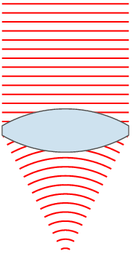
What is a Lens?
An optical device with perfect or approximate axial symmetry, which transmits and refracts light, converging or diverging the beam.
Creates clarity and focus!
Notes:
What happens when we cannot see clearly and we are driving a car at very high speeds on curvy roads, in the mountains?
What happens when we walk in a dark room where we know where everything is located?
What happens when we walk in a dark room where everything is always changing?
The 9Lenses drive clarity and insight into complex and non-linear things…

Slide 43

What is a Lens?
Notes:
What happens when we cannot see clearly and we are driving a car at very high speeds on curvy roads, in the mountains?
What happens when we walk in a dark room where we know where everything is located?
What happens when we walk in a dark room where everything is always changing?
The 9Lenses drive clarity and insight into complex and non-linear things…

Slide 44

What is a Lens?
Notes:
What happens when we cannot see clearly and we are driving a car at very high speeds on curvy roads, in the mountains?
What happens when we walk in a dark room where we know where everything is located?
What happens when we walk in a dark room where everything is always changing?
The 9Lenses drive clarity and insight into complex and non-linear things…

Slide 45
Improving the Paradigm
Content is actionable
Content and metadata framework continues to grow
Inside Out approach
Coupled with outside in

Slide 46

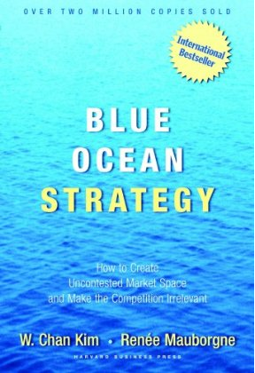
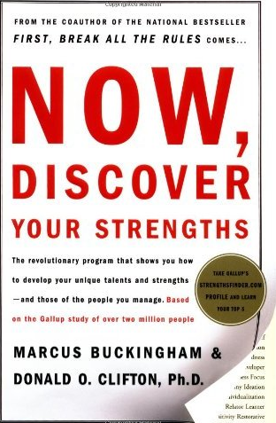


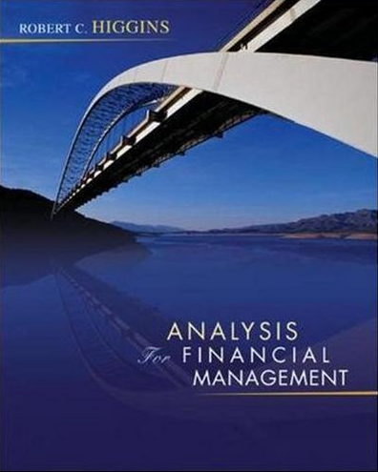

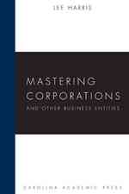
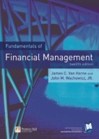

STRUCTURE
ECONOMIC ASSETS
PROCESSES
Market
Strategy
Expectation
Understanding the market, opportunity, characteristics, size, timing, investment, target, customer behavior, positioning, competition, and differentiation
Envisioning and designing the company go to market plan, aids in determining any breakout moves for the organization
The setting, managing, and communication of expectations throughout the organization, and with company stakeholders
People
Operations
Governance
Assessing the people, their motivation, strengths, capabilities; and the culture, who the leaders are, level of transparency and collaboration, what politics and dysfunctions exist
The processes, system, and infrastructure used by the organization, the bridge between strategy and execution
Ensuring the ethical and compliant operation of the organization
Financial
Execution
Entity
Viability of the financial model, assets, liabilities, comparable performance, capital requirements, financial statement strength, constraints
The action or doing, and measurement of the strategy and operations
The type of organization, protection of intellectual property, understanding of legal liabilities
Notes:
Why are their Nine Lenses?
Why a lens?
Rich Content has been created and it easily orients to a lens.
There are specialist and global firms that focus on just one lens
Each lens is a magnifying glass into an essential element of the business.
I use the lens analogy because of what a lens does - It MAGNIFIES.
Go to the course outline…
They are all very important – take BP and the expectation lens
Further, the 9Lenses then allow us to make connections with all other parts of the business is a very simple and cohesive approach.
It allows us to see something that we would not otherwise see.
Just like the human body, after we spend the time self diagnosing and that does not work, and then we ask a friend or two, and that does not work, we then go to a doctor. The general practitioner meets with us, and then if the problem is more complex, and in business, it is always a bit more complex that just meets the eye, they send us to a specialist. That specialist, again, order different view, perspectives, studies, that allow them to diagnose the problem to the best of their ability.
That is exactly what the lenses are for – it is a grouping or segmenting of specialist. The specialist can be rich content, consulting firms, software, processes, or something else that focuses on that element of a business. The more we focus in on that element, the easier it is to see the issue and find specialist that really understand that part of the business.

Slide 47
The 9Lenses™
ECONOMIC ASSETS
PROCESSES
STRUCTURE
Market
Strategy
Expectation
People
Continually
Assess & Align
Continually
Assess & Align
Governance
Execution
Operations
Financial
Entity
Communicate & Ensure
Communicate & Ensure
Communicate & Ensure
Governance
Governance
Governance
Expectation
Expectation
Expectation
Entity
Entity
Execution
Entity
Execution
Execution
Market
Market
Market
Operations
Operations
Operations
Build & Align
Build & Align
Build & Align
Assess & Understand
Assess & Understand
Assess & Understand
People
People
People
Strategy
Strategy
Strategy
Financial
Financial
Financial

Slide 48
COMMUNICATE & ENSURE
ASSESS & UNDERSTAND
BUILD & ALIGN
Market
People
Financial
Strategy
Strategy
Operations
Operations
Execution
Execution
Expectation
Expectation
Governance
Governance
Entity
Entity
Notes:
Why are their Nine Lenses?
Why a lens?
Rich Content has been created and it easily orients to a lens.
There are specialist and global firms that focus on just one lens
Each lens is a magnifying glass into an essential element of the business.
I use the lens analogy because of what a lens does - It MAGNIFIES.
Go to the course outline…
They are all very important – take BP and the expectation lens
Further, the 9Lenses then allow us to make connections with all other parts of the business is a very simple and cohesive approach.
It allows us to see something that we would not otherwise see.
Just like the human body, after we spend the time self diagnosing and that does not work, and then we ask a friend or two, and that does not work, we then go to a doctor. The general practitioner meets with us, and then if the problem is more complex, and in business, it is always a bit more complex that just meets the eye, they send us to a specialist. That specialist, again, order different view, perspectives, studies, that allow them to diagnose the problem to the best of their ability.
That is exactly what the lenses are for – it is a grouping or segmenting of specialist. The specialist can be rich content, consulting firms, software, processes, or something else that focuses on that element of a business. The more we focus in on that element, the easier it is to see the issue and find specialist that really understand that part of the business.

Slide 49
Driving Thoughts
Being great as a business leader is either luck or applied knowledge, maybe a bit of both…
But know that hope is not a strategy…
Great leaders and companies first and foremost - know their customer, they pursue knowing them, they thirst to know them better…
Great leaders and companies then have a pursuit to line all other activities to deliver maximum value for the customer with a derived maximum value creation for both parties…

Slide 50
IMPROVING BUSINESS PROCESSES WITH THE 9LENSES™

Slide 51
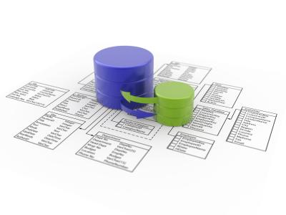
Program Improvement
Assess and Align ECONOMIC ASSETS
Market: The Users and Customers
People: The team operating the program and projects
Financial: The P&L or the budget of the program
Assess and Align PROCESSES
Strategy: What is the big picture and mission?
Operations: What are the systems for accomplishing the vision and mission?
Execution: Is the program on track?
Assess and Align STRUCTURE
Expectations: What has been and is being communicated?
Governance: Is the program audited?
Entity: What is the structure of the contract?

Slide 52
Analytics & Intelligence Platform
Market
Strategy
Expectation
People
Continually
Assess & Align
Continually
Assess & Align
Governance
Execution
Operations
Financial
Entity
Notes:
How are they used?

Slide 53
HOW CAN YOU USE THE 9LENSES™ TO IMPROVE YOUR BUSINESS

Slide 54
Business Process Improvement
Analytics & Intelligence Platform
Business Health & Alignment
Does the Company understand the gaps and opportunities?
Executive Education Platform
Assessing & Aligning Training & Education
Are you training on the gaps and opportunities of the firm?
Customer Relationship Management
Targeting Offerings to Gaps & Opportunities
Is the sale force selling to the business pain of the prospect?
Human Resource Management
Hiring Assessment System
Do the right people get hired for the right jobs?
Corporate or Individual Investment
Investment & Corporate Development System
Most firms fall short of applying consistent and holistic processes to review, assess, and value a business with top areas of focus.

Slide 55
Executive Education Platform Assessing & Aligning Training & Education
Assess
Understand the business through the (9)lenses
Identify Gaps
Where is the business Red or Yellow?
Implement
Build and Measure
Communication and Ensure
Continuous Improvement
Market
Inter-Lens Processes
Globalization: International Marketing (GMU Course)
Strategy is not compelling or differentiated
Collections are high for the industry
Customer delivery is broken
Product issues – bugs in the product offerings
Growth is stalled
Turnover in the employee base
Difficulty in launching new products effectively
Understanding the market
Understanding the customer
Understanding market timing
Intra-Lens Processes
Inter-Lens Disciplines
Marketing Management (GMU Course)
Consumer Behavior (GMU Course)
Intra-Lens Books

Slide 56

Executive Education Platform Assessing & Aligning Training & Education
Market
People
Financial
Inter-Lens Processes
Globalization: International Marketing (GMU Course)
Globalization: MBA 725 International Leadership (GMU Course)
Globalization: International Finance (GMU Course)
Understanding the market
Understanding the customer
Understanding market timing
Job creation and planning
Culture creation
Leadership and management styles
Strength of the financials
Capital structure and formation
Sustainable growth rate
Intra-Lens Processes
Inter-Lens Disciplines
Marketing Management (GMU Course)
Consumer Behavior (GMU Course)
Organizational Behavior (GMU Course)
Leadership (GMU Course)
Corporate Financial Policy (GMU Course)
Business Analysis and Valuation (GMU Course)
Intra-Lens Books

Slide 57
CONNECT YOUR BIG CHALLENGES OR OPPORTUNITIES TO ACTION WITH THE 9LENSES™

Slide 58
Inter-Lens Workflows
Efficiency
Driving efficiency in the business should be done across all 9Lenses
Innovation
We should strive to drive innovation and transformation in all 9lenses of our business. This should be a constant pursuit
Differentiation
Every company has the ability to drive differentiation in one or all of the 9lenses.
Globalization
All 9Lenses are different by each market in which we compete. We should know the lenses by market
CSR
Business leaders should consider all 9Lenses with thinking about corporate social responsibility
How many of you are challenged to innovate in your organization?
How can you have a complete picture around innovation?
How can this be accomplished?

Slide 59
Inter-Lens Workflows
We tend to innovate around our products
We leave out the rest of the organization and lenses
The 9lenses allows us to connect these thoughts

Slide 60
Inter-Lens Workflows
Innovation
We should strive to drive innovation and transformation in all 9lenses of our business. This should be a constant pursuit
MARKET LENS: What are the growth areas for my markets? Where will innovation occur in my markets?
PEOPLE LENS: Where are the best people in my industry? How can I attract them?
FINANCIAL LENS: Where are the most attractive and credible sources of money for growth and innovation?
STRATEGY LENS: What are the best new strategies being leveraged in my market?
OPERATIONS LENS: What are best practices for operations in my industry? Are there game changers?
EXECUTION LENS: Where can the company innovate in standards of performance and measurement?
EXPECATION LENS: How can the company be innovative in setting or aligning expectations across all stakeholders?
GOVERNANCE LENS: What are new governance initiatives that will provide better insight and oversight?
ENTITY LENS: What new innovations are out there for the terms of agreements with customers?

Slide 61
HOW DO THE 9LENSES™ ANALYTICS WORK?

Slide 62
Analytics & Intelligence Platform Business Health & Alignment
Market
Strategy
Expectation
People
Continually
Assess & Align
Continually
Assess & Align
Governance
Execution
Operations
Financial
Entity
Notes:
How are they used?

Slide 63
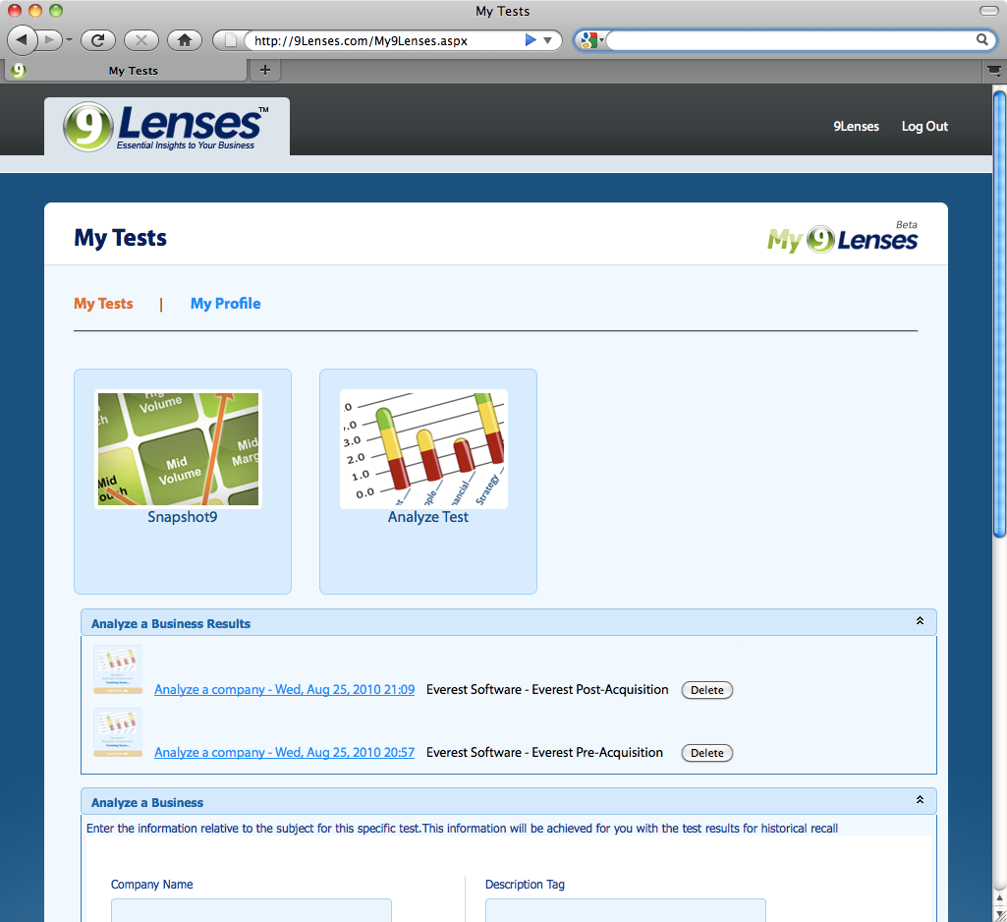
9Lenses Business Assessment
Enable My9Lenses for your business
Enable online and interactive assessments
Gather a multitude of participants
Create a Baseline for your business

Slide 64
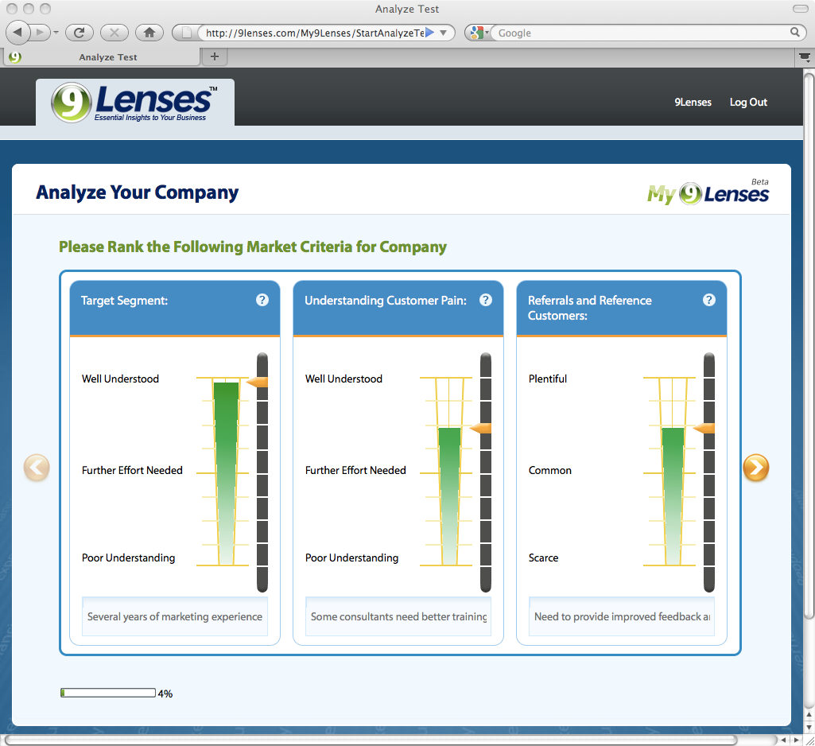
9Lenses Business Assessment
Foster participation, collective learning, and future accountability
Analyze the company using several diagnostics and advanced algorithms
Gain a cross-functional perspective from different levels of the organization

Slide 65
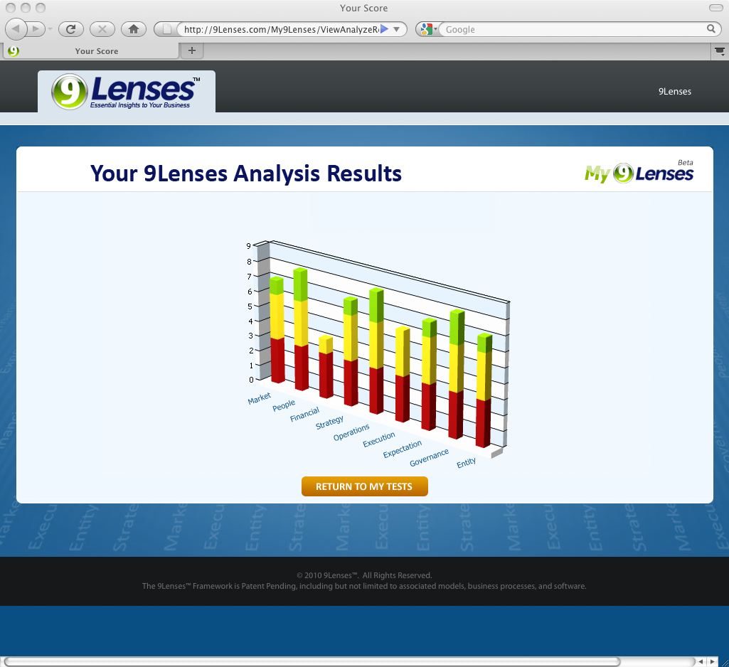
Obtain Results
Enjoy a complete 9Lenses perspective of your business
Zero in on lenses, sub-lenses, or themes for targeted improvement
Zero in on lenses, sub-lenses, or themes for continued success

Slide 66
Executive Education Platform Assessing & Aligning Training & Education
Recommendation Output
Market
Inter-Lens Processes
Globalization: International Marketing (GMU Course)
Understanding the market
Understanding the customer
Understanding market timing
Intra-Lens Processes
Inter-Lens Disciplines
Marketing Management (GMU Course)
Consumer Behavior (GMU Course)
Intra-Lens Books

Slide 67
Aligning Training to Gaps & Opportunities
Market
People
Financial
Inter-Lens Processes
Globalization: International Marketing (GMU Course)
Globalization: MBA 725 International Leadership (GMU Course)
Globalization: International Finance (GMU Course)
Understanding the market
Understanding the customer
Understanding market timing
Job creation and planning
Culture creation
Leadership and management styles
Strength of the financials
Capital structure and formation
Sustainable growth rate
Intra-Lens Processes
Inter-Lens Disciplines
Marketing Management (GMU Course)
Consumer Behavior (GMU Course)
Organizational Behavior (GMU Course)
Leadership (GMU Course)
Corporate Financial Policy (GMU Course)
Business Analysis and Valuation (GMU Course)
Intra-Lens Books

Slide 68
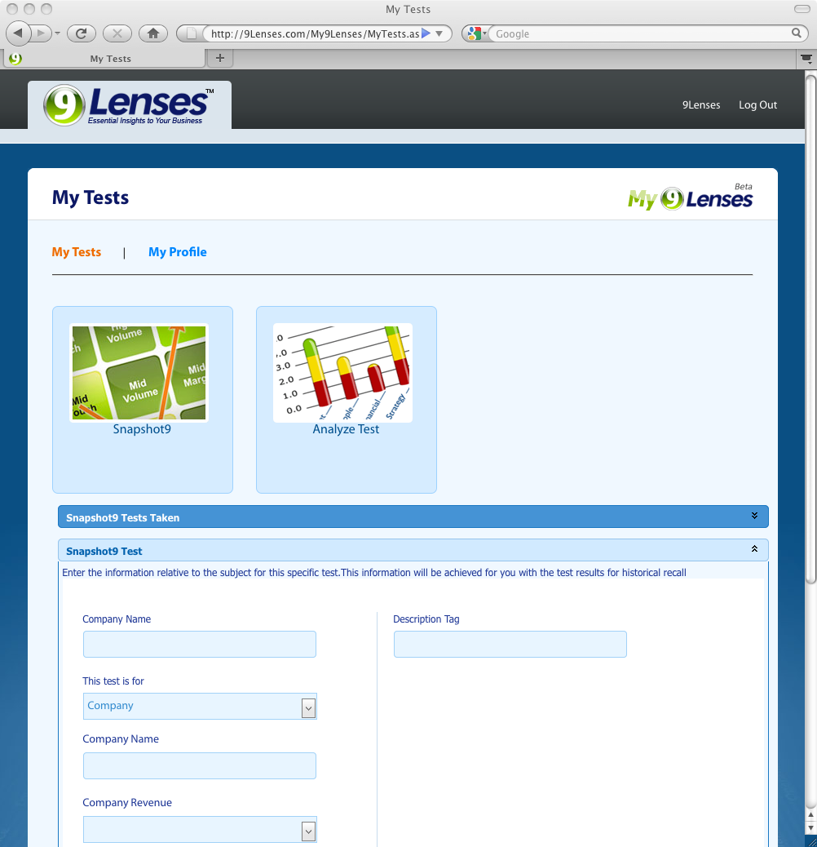
Snapshot9 Business Model Assessment
Understand the business model of the business as a team
Assess and discuss the drivers of the business model
Drive collective understanding and learning in this area

Slide 69
GOING DEEPER IN THE 9LENSES™

Slide 70
THE ECONOMIC ASSETS
ECONOMIC ASSETS
Market
Understanding the market, opportunity, characteristics, size, timing, investment, target, customer behavior, positioning, competition, and differentiation
People
Assessing the people, their motivation, strengths, capabilities; and the culture, who the leaders are, level of transparency and collaboration, what politics and dysfunctions exist
Financial
Viability of the financial model, assets, liabilities, comparable performance, capital requirements, financial statement strength, constraints

Slide 71
The Market Lens
Market
Governance
Expectation
Execution
Entity
Focuses on understanding the market in which the business competes and the business’s customers.
This Lens is not about Marketing which is a cross-functional discipline.
Most businesses lack of clarity and focus on knowing their market and customer.
Most businesses mix strategy and operations into their market understanding. They jump from understanding the market to a discussion of how to sell and deliver their products.
Without a compelling market and a customer with pain that can be solved, the rest of the lenses are much less important.
Our businesses and their valuations are often defined by the market in which we compete.
Market
Operations
People
Strategy
Financial
Communicate & Ensure
Governance
Expectation
Execution
Entity
Market
Operations
Build & Align
Assess & Understand
People
Strategy
Financial
Notes:
There are five key elements to the Market Lens
The Dance Example…

Slide 72
Market
Characteristics
Understanding the market, opportunity, characteristics, size, timing, investment, target, customer behavior, positioning, competition, and differentiation
Competition
Customer
Positioning
Timing
An Internet Gaming Business Example

Slide 73
ASSESS & UNDERSTAND the Market Lens
Characteristics
What is the Size of the market?
Competition
What is the
Competitive
Landscape?
Customer
How do they act?
Positioning
How does the
product fit the
Market?
Timing
What time is it in the Market?

Slide 74
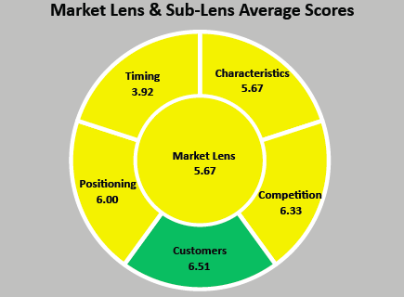
The Market Sub-lenses
Baseline Assessment of an Organization
Let’s focus on Timing at 3.92
What are some conclusions?
Could this mean the market is cluttered?
Could this mean they are early to market?
What is your market timing?
How do you know? Do you know?

Slide 75
Price Sensitivity
Financial Strength
Sales & Marketing
Demand
Barriers
Product Expectations
Target
New Players
Adoption
Investment
Exit Paths
Referrals
Growth
Market Leaders
Regulation
Market Maturity
Price Competition
Segment
Pain Points
Vertical Specific Expertise
Rank
Brand Awareness
Opportunity
Size
Consolidation
Innovation
Purchasing Cycle
Number
Sales Cycle
Attributes
Differentiated Offering
Analyst Perception
Multiple Segments
Alignment
Time to Market

Slide 76
Lens
Market
Sub- Lens
Market Characteristics
Competition
Customer
Positioning
Timing
Segment
Opportunity
Size
Growth
Barriers
Regulation
Demand
Investment
Sales Cycle
Number
Financial Strength
Innovation
New Players
Price Competition
Rank
Sales & Marketing
Target
Multiple Segments
Pain Points
Purchasing Cycle
Attributes
Alignment
Referrals
Price Sensitivity
Product Expectations
Market Leaders
Differentiated Offering
Brand Awareness
Analyst Perception
Vertical Specific Expertise
Market Maturity
Time to Market
Adoption
Consolidation
Exit Paths
Themes
How big is the market?
Are there many regulatory barriers?
What innovation is taking place in the market?
How well does sales & marketing align to the way the customer wants to buy?
Is the company a market leader?
Who are the market leaders?
How old is this segment?
What consolidation is occurring?
Diagnostics

Slide 77





Market Lens ≈ Positioning ≈ Differentiated Offerings

Slide 78
The People Lens
People
Entity
The People Lens seeks to understand the people and culture of a business.
The People Lens looks at the human element and seeks to understand the business through the lens of the people. Is the culture collaborative? Expressive? Candid? Are the People motivated? If not, why not?
The people in the business will make or break the financial success of the entity.
The People Lens not only aids a leader in assessing the people in the Company, it also provides a model for assessing, recruiting, and retaining leaders.
Assessing the people that are in the business is both art and science.
Great cultures: Possess a Shared Vision, Demonstrate Commitment, Foster Leadership, Provide Membership, Seeks Accountability, and Innovates.
The Measurement(13)™ Framework:
Governance
Expectation
Market
People
Execution
Financial
Operations
Strategy
Communicate & Ensure
Governance
Expectation
Execution
Entity
Market
Operations
Build & Align
Assess & Understand
People
Strategy
Financial
Resilience
Passion
Network
Critical Thinking
Ethics
Communication
Authenticity
Tenacity
Experience
Resource State
Problem Solving
Humility
Aptitude
Notes:
The beginning of the people lens – RTP and then how things were added…
But the People lens also included the culture

Slide 79
People
Employee Characteristics
Assessing the people, their motivation, strengths, capabilities; and the culture, who the leaders are, level of transparency and collaboration, what politics and dysfunctions exist
Leadership
Organizational Design
Culture
R, T, P, E, N, R, CT, PS – Oh no… Ethics…

Slide 80
The People Lens
People
Entity
The People Lens seeks to understand the people and culture of a business.
The People Lens looks at the human element and seeks to understand the business through the lens of the people. Is the culture collaborative? Expressive? Candid? Are the People motivated? If not, why not?
The people in the business will make or break the financial success of the entity.
The People Lens not only aids a leader in assessing the people in the Company, it also provides a model for assessing, recruiting, and retaining leaders.
Assessing the people that are in the business is both art and science.
Great cultures: Possess a Shared Vision, Demonstrate Commitment, Foster Leadership, Provide Membership, Seeks Accountability, and Innovates.
Governance
Expectation
Market
People
Execution
Financial
Operations
Strategy
Communicate & Ensure
Governance
Expectation
Execution
Entity
Market
Operations
Build & Align
Assess & Understand
People
Strategy
Financial
Notes:
The beginning of the people lens – RTP and then how things were added…
But the People lens also included the culture

Slide 81
ASSESS & UNDERSTAND the People Lens
Employee Characteristics
What are the employees strengths?
Culture
Is the culture of the business healthy?
Leadership
What is the leadership style of the business leaders?
Organizational Design
What are the key functions of the organization?

Slide 82
People Lens ≈ Great Cultures
Possess a Shared VISION
Demonstrate COMMITMENT
Foster LEADERSHIP
Feel MEMBERSHIP
Leads to ACCOUNTABILITY & INNOVATION

Slide 83
Lens
People
Sub- Lens
Employee Characteristics
Culture
Leadership
Organizational Design
Strengths
Attitude
Resilience
Tenacity
Passion
Experiences
Network
Resource State
Critical Thinking
Problem Solving
Ethics
Communication
Aptitude
Authenticity
Humility
4 Levels of Communication
Politics
Culture of Execution
Turnover
Accountability
Transparency
Trust
Infighting
Values
Elephants in the Room
Management Experience
Organizational Leader
Leadership Team Strengths
Leaders
Commitment
Visionary Leadership
Right People / Right Places
Key Functions in the Organization
Job Alignment
Critical Jobs
Themes
Describe the current employees strengths.
Are there significant politics within the organization?
Are there visionary leaders in the organization?
Are the right people doing the right jobs in the organization?
Diagnostics

Slide 84
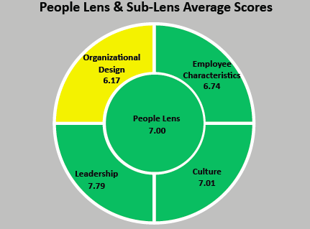
The People Sub-lenses
Baseline Assessment of an Organization
Let’s focus on OD at 6.17
What are some conclusions?
Are the right jobs staffed?
Do the employees think they are staffed correctly?
Could the reporting structures be better aligned to achieve the strategy?

Slide 85
People Lens ≈ Organizational Design ≈ Right People / Right Places
People are made to do and love certain things!
How can we know this?
What do we do about it when we know this?

Slide 86
People Lens ≈ Employee Characteristics
Start with RTP, but that is not enough!
Network
Resilience
Critical Thinking
Authenticity
Ethics
Passion
Communication
Tenacity
Experience
Resource State
Problem Solving
Humility
Aptitude

Slide 87
An Overview
Entity
Governance
Expectation
Market
Execution
People
Financial
Operations
Strategy
Resilience
RESILIENCE
Spring Back! Never felt it! Returning to the original form or position after being bent; Recovering readily from illness, depression, adversity, or the like, buoyant.
Notes:
The Measurement(13) framework is the framework I use to assess, recruit, and train leaders. It is a simple model. I have found that simple models are usually easier. The model houses 13 traits and abilities that I have found in the best leaders. These traits and abilities are measured by the job that person is applying to do, or is already doing daily. I do believe that to be a great leader in any field you need to possess all of these traits. It’s a tall order. These traits and abilities are in the best doctors, lawyers, CEO’s, sales leaders, and other leaders that I have seen thus far in my career. I have seen some leaders with high scores in some of the traits and abilities and low scores in others. Until these leaders are able to develop all of the traits and abilities in M(13), they will not achieve all they could achieve in their lives and careers.

Slide 88
An Overview
Entity
Governance
Expectation
Market
Execution
People
Financial
Operations
Strategy
Resilience
Tenacity
TENACITY
Never let go! Never lose sight of the goal! Holding together; cohesive; not easily pulled asunder; tough; pertinacious, persistent, stubborn, holding fast; characterized by keeping a firm hold.
Notes:
The Measurement(13) framework is the framework I use to assess, recruit, and train leaders. It is a simple model. I have found that simple models are usually easier. The model houses 13 traits and abilities that I have found in the best leaders. These traits and abilities are measured by the job that person is applying to do, or is already doing daily. I do believe that to be a great leader in any field you need to possess all of these traits. It’s a tall order. These traits and abilities are in the best doctors, lawyers, CEO’s, sales leaders, and other leaders that I have seen thus far in my career. I have seen some leaders with high scores in some of the traits and abilities and low scores in others. Until these leaders are able to develop all of the traits and abilities in M(13), they will not achieve all they could achieve in their lives and careers.

Slide 89
An Overview
Entity
Governance
Expectation
Market
Execution
People
Financial
Operations
Strategy
Resilience
Passion
Tenacity
PASSION
The state of the mind when it is powerfully acted upon and influenced by something external to itself; the state of any particular faculty which, under such conditions, becomes extremely sensitive or uncontrollably excited; an extreme or inordinate desire;
Notes:
The Measurement(13) framework is the framework I use to assess, recruit, and train leaders. It is a simple model. I have found that simple models are usually easier. The model houses 13 traits and abilities that I have found in the best leaders. These traits and abilities are measured by the job that person is applying to do, or is already doing daily. I do believe that to be a great leader in any field you need to possess all of these traits. It’s a tall order. These traits and abilities are in the best doctors, lawyers, CEO’s, sales leaders, and other leaders that I have seen thus far in my career. I have seen some leaders with high scores in some of the traits and abilities and low scores in others. Until these leaders are able to develop all of the traits and abilities in M(13), they will not achieve all they could achieve in their lives and careers.

Slide 90
An Overview
Entity
Governance
Expectation
Market
Execution
People
Financial
Operations
Strategy
Resilience
Passion
Tenacity
Experience
EXPERIENCE
An act of knowledge, one or more, by which single facts or general truths are ascertained; experimental or inductive knowledge; hence, implying skill, facility, or practical wisdom gained by personal knowledge, feeling or action.
Notes:
The Measurement(13) framework is the framework I use to assess, recruit, and train leaders. It is a simple model. I have found that simple models are usually easier. The model houses 13 traits and abilities that I have found in the best leaders. These traits and abilities are measured by the job that person is applying to do, or is already doing daily. I do believe that to be a great leader in any field you need to possess all of these traits. It’s a tall order. These traits and abilities are in the best doctors, lawyers, CEO’s, sales leaders, and other leaders that I have seen thus far in my career. I have seen some leaders with high scores in some of the traits and abilities and low scores in others. Until these leaders are able to develop all of the traits and abilities in M(13), they will not achieve all they could achieve in their lives and careers.

Slide 91
An Overview
Entity
Governance
Expectation
Market
Execution
People
Financial
Operations
Strategy
Resilience
Passion
Network
Tenacity
Experience
NETWORK
An interconnected system of things or people; communicate with and within a group; an association of individuals having a common interest, formed to provide mutual assistance.
Notes:
The Measurement(13) framework is the framework I use to assess, recruit, and train leaders. It is a simple model. I have found that simple models are usually easier. The model houses 13 traits and abilities that I have found in the best leaders. These traits and abilities are measured by the job that person is applying to do, or is already doing daily. I do believe that to be a great leader in any field you need to possess all of these traits. It’s a tall order. These traits and abilities are in the best doctors, lawyers, CEO’s, sales leaders, and other leaders that I have seen thus far in my career. I have seen some leaders with high scores in some of the traits and abilities and low scores in others. Until these leaders are able to develop all of the traits and abilities in M(13), they will not achieve all they could achieve in their lives and careers.

Slide 92
An Overview
Entity
Governance
Expectation
Market
Execution
People
Financial
Operations
Strategy
Resilience
Passion
Network
Tenacity
Experience
Resource State
RESOURCE STATE
A continued state of learning, ability to learn from many areas, books, experiences, other people, etc… A thirst for knowledge in many areas will be easily seen. There will be a drive to improve.
Notes:
The Measurement(13) framework is the framework I use to assess, recruit, and train leaders. It is a simple model. I have found that simple models are usually easier. The model houses 13 traits and abilities that I have found in the best leaders. These traits and abilities are measured by the job that person is applying to do, or is already doing daily. I do believe that to be a great leader in any field you need to possess all of these traits. It’s a tall order. These traits and abilities are in the best doctors, lawyers, CEO’s, sales leaders, and other leaders that I have seen thus far in my career. I have seen some leaders with high scores in some of the traits and abilities and low scores in others. Until these leaders are able to develop all of the traits and abilities in M(13), they will not achieve all they could achieve in their lives and careers.

Slide 93
An Overview
Entity
Governance
Expectation
Market
Execution
People
Financial
Operations
Strategy
Network
Resilience
Passion
Critical Thinking
Tenacity
Experience
Resource State
CRITICAL THINKING
Critical thinking involves determining the meaning and significance of what is observed or expressed, or, concerning a given inference or argument, determining whether there is adequate justification to accept the conclusion as true. Hence, Fisher & Scriven define critical thinking as "Skilled, active, interpretation and evaluation of observations, communications, information, and argumentation.” Critical thinking employs not only logic but broad intellectual criteria such as clarity, credibility, accuracy, precision, relevance, depth, breadth, significance and fairness.
Notes:
The Measurement(13) framework is the framework I use to assess, recruit, and train leaders. It is a simple model. I have found that simple models are usually easier. The model houses 13 traits and abilities that I have found in the best leaders. These traits and abilities are measured by the job that person is applying to do, or is already doing daily. I do believe that to be a great leader in any field you need to possess all of these traits. It’s a tall order. These traits and abilities are in the best doctors, lawyers, CEO’s, sales leaders, and other leaders that I have seen thus far in my career. I have seen some leaders with high scores in some of the traits and abilities and low scores in others. Until these leaders are able to develop all of the traits and abilities in M(13), they will not achieve all they could achieve in their lives and careers.

Slide 94
An Overview
Entity
Governance
Expectation
Market
Execution
People
Financial
Operations
Strategy
Network
Resilience
Passion
Critical Thinking
Tenacity
Experience
Problem Solving
Resource State
PROBLEM SOLVING
A mental process and is part of the larger problem process that includes problem finding and problem shaping. Considered the most complex of all intellectual functions, problem solving has been defined as higher-order cognitive process that requires the modulation and control of more routine or fundamental skills. Problem solving occurs when an organism or an artificial intelligence system needs to move from a given state to a desired goal state.
Notes:
The Measurement(13) framework is the framework I use to assess, recruit, and train leaders. It is a simple model. I have found that simple models are usually easier. The model houses 13 traits and abilities that I have found in the best leaders. These traits and abilities are measured by the job that person is applying to do, or is already doing daily. I do believe that to be a great leader in any field you need to possess all of these traits. It’s a tall order. These traits and abilities are in the best doctors, lawyers, CEO’s, sales leaders, and other leaders that I have seen thus far in my career. I have seen some leaders with high scores in some of the traits and abilities and low scores in others. Until these leaders are able to develop all of the traits and abilities in M(13), they will not achieve all they could achieve in their lives and careers.

Slide 95
An Overview
Entity
Governance
Expectation
Market
Execution
People
Financial
Operations
Strategy
Network
Resilience
Passion
Critical Thinking
Tenacity
Experience
Ethics
Problem Solving
Resource State
ETHICS
The science of human duty; the body of rules of duty drawn from this science; a particular system of principles and rules concerting duty, whether true or false; rules of practice in respect to a single class of human actions.
Notes:
The Measurement(13) framework is the framework I use to assess, recruit, and train leaders. It is a simple model. I have found that simple models are usually easier. The model houses 13 traits and abilities that I have found in the best leaders. These traits and abilities are measured by the job that person is applying to do, or is already doing daily. I do believe that to be a great leader in any field you need to possess all of these traits. It’s a tall order. These traits and abilities are in the best doctors, lawyers, CEO’s, sales leaders, and other leaders that I have seen thus far in my career. I have seen some leaders with high scores in some of the traits and abilities and low scores in others. Until these leaders are able to develop all of the traits and abilities in M(13), they will not achieve all they could achieve in their lives and careers.

Slide 96
An Overview
Entity
Governance
Expectation
Market
Execution
People
Financial
Operations
Strategy
Network
Communication
Resilience
Passion
Critical Thinking
Tenacity
Experience
Ethics
Problem Solving
Resource State
COMMUNICATION
The imparting or interchange of thoughts, opinions, or information by speech, writing, or signs. Although there is such a thing as one-way communication, communication can be perceived better as a two-way process in which there is an exchange and progression of thoughts, feelings or ideas (energy) towards a mutually accepted goal or direction (information).
Notes:
The Measurement(13) framework is the framework I use to assess, recruit, and train leaders. It is a simple model. I have found that simple models are usually easier. The model houses 13 traits and abilities that I have found in the best leaders. These traits and abilities are measured by the job that person is applying to do, or is already doing daily. I do believe that to be a great leader in any field you need to possess all of these traits. It’s a tall order. These traits and abilities are in the best doctors, lawyers, CEO’s, sales leaders, and other leaders that I have seen thus far in my career. I have seen some leaders with high scores in some of the traits and abilities and low scores in others. Until these leaders are able to develop all of the traits and abilities in M(13), they will not achieve all they could achieve in their lives and careers.

Slide 97
An Overview
Entity
Governance
Expectation
Market
Execution
People
Financial
Operations
Strategy
Network
Communication
Resilience
Passion
Critical Thinking
Humility
Tenacity
Experience
Ethics
Problem Solving
Resource State
HUMILITY
Near the ground; not high or lofty; not pretentious or magnificent; unpretending; unassuming; as, a humble cottage. Thinking lowly of one's self; claiming little for one's self; not proud, arrogant, or assuming; thinking one's self ill-deserving or unworthy, when judged by the demands of God; lowly; weak; modest.
Notes:
The Measurement(13) framework is the framework I use to assess, recruit, and train leaders. It is a simple model. I have found that simple models are usually easier. The model houses 13 traits and abilities that I have found in the best leaders. These traits and abilities are measured by the job that person is applying to do, or is already doing daily. I do believe that to be a great leader in any field you need to possess all of these traits. It’s a tall order. These traits and abilities are in the best doctors, lawyers, CEO’s, sales leaders, and other leaders that I have seen thus far in my career. I have seen some leaders with high scores in some of the traits and abilities and low scores in others. Until these leaders are able to develop all of the traits and abilities in M(13), they will not achieve all they could achieve in their lives and careers.

Slide 98
An Overview
Entity
Governance
Expectation
Market
Execution
People
Financial
Operations
Strategy
Network
Communication
Resilience
Passion
Critical Thinking
Humility
Tenacity
Experience
Ethics
Problem Solving
Aptitude
Resource State
APTITUDE
Capability; ability; innate or acquired capacity for something; talent: She has a special aptitude for mathematics. 2. readiness or quickness in learning; intelligence: He was placed in honors classes because of his general aptitude. A natural or acquired disposition or capacity for a particular purpose, or tendency to a particular action or effect; as, oil has an aptitude to burn.
Notes:
The Measurement(13) framework is the framework I use to assess, recruit, and train leaders. It is a simple model. I have found that simple models are usually easier. The model houses 13 traits and abilities that I have found in the best leaders. These traits and abilities are measured by the job that person is applying to do, or is already doing daily. I do believe that to be a great leader in any field you need to possess all of these traits. It’s a tall order. These traits and abilities are in the best doctors, lawyers, CEO’s, sales leaders, and other leaders that I have seen thus far in my career. I have seen some leaders with high scores in some of the traits and abilities and low scores in others. Until these leaders are able to develop all of the traits and abilities in M(13), they will not achieve all they could achieve in their lives and careers.

Slide 99
An Overview
Entity
Governance
Expectation
Market
Execution
People
Financial
Operations
Strategy
Network
Communication
Critical Thinking
Authenticity
Resilience
Passion
Humility
Tenacity
Experience
Ethics
Problem Solving
Aptitude
Resource State
AUTHENTICITY
Having a genuine original or authority, in opposition to that which is false, fictitious, counterfeit, or apocryphal; being what it purports to be; genuine; not of doubtful origin; real;
Notes:
The Measurement(13) framework is the framework I use to assess, recruit, and train leaders. It is a simple model. I have found that simple models are usually easier. The model houses 13 traits and abilities that I have found in the best leaders. These traits and abilities are measured by the job that person is applying to do, or is already doing daily. I do believe that to be a great leader in any field you need to possess all of these traits. It’s a tall order. These traits and abilities are in the best doctors, lawyers, CEO’s, sales leaders, and other leaders that I have seen thus far in my career. I have seen some leaders with high scores in some of the traits and abilities and low scores in others. Until these leaders are able to develop all of the traits and abilities in M(13), they will not achieve all they could achieve in their lives and careers.

Slide 100
The Financial Lens
Financial
Market
Entity
The past and future financial performance of an entity is highly predictive of what a company is and can become.
The capital consumed by the company coupled and the structure by which it was taken is very important to understand.
The Financial Lens provides insights to change the business model.
The Snapshot(9)™ assessment model:
Governance
People
Financial
Expectation
Strategy
Execution
Operations
High
Touch
High
Volume
High
Margin
Communicate & Ensure
Governance
Expectation
Execution
Entity
Mid
Touch
Mid
Volume
Mid
Margin
Market
Operations
Build & Align
Assess & Understand
People
Strategy
Financial
Low
Touch
Low
Volume
Low
Margin
Notes:
Capital Structure and rights a tough lesson in the Financial lens

Slide 101
Financial
Historical Performance
Viability of the financial model, assets, liabilities, comparable performance, capital requirements, financial statement strength, constraints
Accounting
Capital Structure
Forecasting
Financial Model
We need a “D” Round

Slide 102
ASSESS & UNDERSTAND the Financial Lens
Accounting
Does the company follow GAAP accounting procedures?
Capital Structure
Is the capital structure of the business good?
Financial Model
Does the company have a scalable financial model?
Forecasting
What is the target growth rate of the business?
Historical Performance
What has been the past performance of the business?

Slide 103
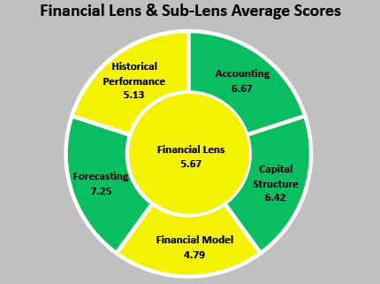
The Financial Sub-lenses
Baseline Assessment of an Organization
Let’s focus on Financial Model at 4.79
What are some conclusions?
Are there costs in their financial model that are not productive?
Is the volume of orders low or high?
Are the margins being squeezed by customers or partners?

Slide 104
Lens
Financial
Sub- Lens
Accounting
Capital Structure
Financial Model
Forecasting
Historical Performance
Financial Statements
Audits
Cash Collections Cycles
GAAP
Capital Requirements
Rights
Cost of Capital
Cap Structure
Investor Goals
Liquidity
Capital Formation
Employee Ownership
Revenue Model
Financial Model
Industry Comps
Profitability Drivers
Volume
Margin
Touch
Target Growth Rate
Appetite for Growth
Pro-forma
Revenue Potential
Economy of Scale
Balance Sheet Strength
Revenue Performance
Net Margin
EBITDA
Segment Performance Comps
Use of Cash
Gross Margin
Growth Rates
Customers
Themes
Does the company have audited financial statements?
What is the age of the funds that are invested? Are they near end of life? Any dry powder?
What is the financial model of the business?
Are there one or two year pro-forma’s? Is there a sensitivity analysis for these?
What is the strength of the Balance Sheet?
Diagnostics

Slide 105
Financial Lens
Who has made a significant investment into a large company?
A lesson in capital structure.
Notes:
Global business
20 plus million of capital in…
Consortium of Investors
A round was very different than the C Round…

Slide 106
THE PROCESSES
PROCESSES
Strategy
Envisioning and designing the company go to market plan, aids in determining any breakout moves for the organization
Operations
The people, processes, and systems infrastructure used by the organization, the bridge between strategy and execution
Execution
The action or doing, and measurement of the strategy and operations

Slide 107
The Strategy Lens
Strategy
People
Market
Entity
Financial
The Strategy lens encompasses ENVISIONING & DESIGNING the Company go to market plan and aids in determining if there are any real break out moves.
The Strategy lens houses Kotler’s four P’s which are Product, Place, Price, & Promotion.
Strategy is best formed after truly understanding the Market, People, and Financial situation of the Company.
There is a feedback loop into the Strategy lens upon some period of Execution, which is action and measurement.
The Strategy Lens is the first lens in the Build & Align phase.
This Lens includes the M(9) Strategy Formation Principles.
Strategy
Governance
Operations
Expectation
Execution
Communicate & Ensure
Governance
Expectation
Execution
Entity
Market
Operations
Build & Align
Assess & Understand
People
Strategy
Financial

Slide 108
Strategy
Envisioning and designing the company go to market plan, aids in determining any breakout moves for the organization
General Strategy
Pricing Strategy
Delivery Outlets
Offerings
Promotion
Increasing prices while reducing promotion

Slide 109
ASSESS & UNDERSTAND the Strategy Lens
General Strategy
What is the strategic vision of the business?
Offerings
What are the product offerings of the business?
Pricing Strategy
How are the product offerings priced?
Promotion
How are the product offerings promoted?
Delivery Outlets
What are the sales channels of the company?

Slide 110
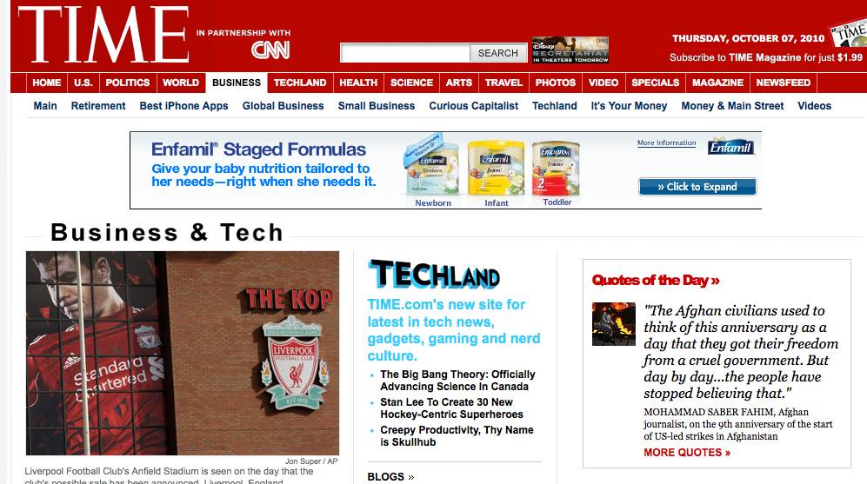


Strategy Lens ≈ Pricing Strategy ≈ Price Optimization
Subscription
Advertising
Subscription and Advertising
Premium subscription – back to the market lens – what do the customers value?
Innovators / Early Adopters / Mainstream / Laggards effect our strategy…

Slide 111
Birds of a Feather Flock Together
Build a Profitable Business
Keep these core themes in mind as you design the strategy…
KISS
Focus, Focus, Focus
Take a Chance!
Look Forward, Innovate, Live in a Resource State
Create a Snapshot9 Financial Model
Build Flat and Empower Organizations
Give More than You Receive

Slide 112

The Strategy Sub-lenses
Baseline Assessment of an Organization
There are two yellows and three greens, but the company is yellow in the lens…
How will the leadership know where the strategy is deficient?
Knowing this can drive alignment in the operations and execution lenses…

Slide 113
Lens
Strategy
Sub- Lens
General Strategy
Offerings
Pricing Strategy
Promotion
Delivery Outlets
Strategic Vision
Strategic Roadmap
Corporate Mission
Exit Strategy
Growth Opportunities
Differentiation Strategy
Strategy Plausibility
Products/Services
Adoption
Value Proposition
Stickiness
Complexity
Innovation
Verticalization
Volume
Roadmap
Price Optimization
Pricing Strategy
Current Pricing
Discounting
Sales Model
Web Strategy
Promotion Strategy
Channel Support
Lead Generation
Go To Market
Sales Channels
Other Channels
Number of Segments
Location
Partner Network
Themes
What is the business and what will it become?
What is the value proposition of the business?
What is the pricing strategy of the business?
Does the Approach to market make sense?
What are the sales channels employed by the business?
Diagnostics

Slide 114
The Operations Lens
Operations
Financial
People
Market
Strategy
The Operations Lens encompasses the tactics planning and infrastructure that brings the Strategy to life.
The Operations Lens focuses on the processes, systems, and infrastructure leveraged by the organization and this lens houses the needed elements that are the bridge between Strategy and Execution.
Operations is all about the infrastructure leveraged to complete the Strategy of the business.
This is a deep dive into the internal workings of the company and the tools used in operations.
It is the logistics and plans to complete the Strategy.
The Operations Lens focuses on things such as the sales process and the database used to capture the information about prospects and customers.
The Operations Lens is where the envisioning and design of the people, process, and systems to fulfill the go to market plan occurs.
What are the key systems and processes?
Is there a Strategy Map or an alternative set of tools being employed to ensure success in developing the needed processes?
This Lens includes the designing the Gantt Chart.
Operations
Entity
Execution
Governance
Expectation
Communicate & Ensure
Governance
Expectation
Execution
Entity
Market
Operations
Build & Align
Assess & Understand
People
Strategy
Financial

Slide 115
Operations
General Operations
The processes, system, and infrastructure used by the organization, the bridge between strategy and execution
Processes
Systems
Infrastructure
The Power of Connected Systems

Slide 116
ASSESS & UNDERSTAND the Operations Lens
General Operations
Where are the bottlenecks or chokepoints in the operation?
Infrastructure
What are the key reports used by the business to make decisions?
Processes
How are the functions integrated?
Systems
What are the systems the company uses?

Slide 117

The Operations Sub-lenses
Baseline Assessment of an Organization
What happens when a companies systems are not keeping pace with what is needed? In one year? In two years?
Will the margins be impacted?

Slide 118
Lens
Operations
Sub- Lens
General Operations
Infrastructure
Processes
Systems
Operational Challenges
Scalability
Operational Efficiency
Organizational Chart
Operational Decisions
Organizational Structure
Documentation
Capacity
Functions
Staffing
Facilities
SWOT
Production
Planning
Clear Objectives
KPIs
Controls
Key Processes
Training
Data Collection
Customer Systems
Financial Systems
Employee Systems
Other Systems
Reporting
Linkages
Themes
Where are the bottlenecks or chokepoints in the operation?
What are the key reports used by the business to make decisions?
How are the functions integrated?
What are the systems the company uses?
Diagnostics

Slide 119
Operations Lens ≈ Systems ≈ Data Collection
?

Slide 120
The Execution Lens
Execution
Strategy
Financial
People
Operations
Execution is the ACTION & MEASURMENT of the Strategy and Operations Lenses.
Execution is the doing of the plan and the measurement of is it working or not.
Is the company getting things done? What works and what does not? What needs to change?
Are the sales people selling the product in a consistent manner?
What are the KPI’s and what is the outcome?
How is the company doing at executing the desired strategy, and operating plans?
The Execution Lens reveals how the Strategy and Operations are performing.
You may tweak your strategy and operations, but only based on the measurement of your execution.
Successful Action & Measurement in this lens will lead to a continual assessment of the Market, People, and Financial lenses, which will then foster improvements in the Strategy and Operations lenses.
Ideas are everywhere, execution is where the rubber meets the road!
Execution
Market
Expectation
Entity
Governance
Communicate & Ensure
Governance
Expectation
Execution
Entity
Market
Operations
Build & Align
Assess & Understand
People
Strategy
Financial

Slide 121
Execution
The action or doing, and measurement of the strategy and operations
Measurement
Performance
Building Measurements for GROWTH – what profits?

Slide 122
ASSESS & UNDERSTAND the Execution Lens
Measurement
Are the target growth rates set high enough?
Performance
What has been the performance of the KPI’s?

Slide 123

The Execution Sub-lenses
Baseline Assessment of an Organization
Can a company execute well, but be red or yellow in other lenses?
They could be measuring the wrong things
OR they could be on their way to greens in other lenses…

Slide 124
Bringing 3 Lenses Together
Market
Strategy
Expectation
People
Continually
Assess & Align
Continually
Assess & Align
Governance
Execution
Operations
Financial
Entity
Execution drives adjustments to the Strategy and Operations
Changes in the other lenses drives changes to Strategy, Operations, and Execution
Notes:
Invade Europe by plane and boat on a certain day
How many boats? Amount of food? Delivery process and systems?
Are the boats built? Are the troops trained? Did we land? What happened? What did not work?

Slide 125
Lens
Execution
Sub- Lens
Measurement
Performance
KPIs
Employee Effort
Priorities
Profits
Succession Planning
Customer Feedback
Goals
Strategic Execution
Product Release
Quality
Resourcing
Execution Against Planning
Growth
Programs
Financial
Human Capital
Market
Themes
Are the target growth rates set high enough?
What has been the performance of the KPI’s?
Diagnostics

Slide 126
THE STRUCTURE
STRUCTURE
Expectation
The setting, managing, and communication of expectations throughout the organization, and with company stakeholders
Governance
Ensuring the ethical and compliant operation of the organization
Entity
The type of organization, protection of intellectual property, understanding of legal liabilities

Slide 127
The Expectation Lens
Expectation
Operations
Strategy
Financial
Execution
Expectations are key to success; the quicker you reach it is what it is with the key stakeholders, the better off you are in the short and long run.
Expectations are key in projecting sales pipelines, role definitions, financial performance, and much more…
If expectations are not set and managed, how can success be gauged?
Prior to taking or once you are in a role, reaching common expectations for the future for all stakeholders is a key component of success.
Can all of the key stakeholders reach “it is what it is?”
Can candid and transparent conversations be held, or is there tip toeing and avoidance due to tough issues where interest are not aligned?
Can common expectations can be achieved prior to taking a job? If not, what are the risk for you in your new role?
Who will be working against you given their interest do not align?
Aligning expectations around what is success in a go to market strategy is key!
If there is non-alignment on expectations, the cost of capital for the next round is tough to determine.
Expectation
People
Governance
Market
Entity
Communicate & Ensure
Governance
Expectation
Execution
Entity
Market
Operations
Build & Align
Assess & Understand
People
Strategy
Financial
Notes:
Not many books on the bookshelf
Blows my mind – first place a CEO makes big mistakes
Sets expectations before really understanding the situation…
We are always setting expectations

Slide 128
Expectation
The setting, managing, and communication of expectations throughout the organization, and with company stakeholders
All Stakeholders
Board & Shareholders
Partners
Employees
Customers
A REALLY BAD first Board Meeting

Slide 129
ASSESS & UNDERSTAND the Expectation Lens
All Stakeholders
What has been communicated about the future of the Company, both internally and externally?
Board &
Shareholders
Do the board and shareholders have consistent expectations?
Customers
What do customers expect from the product?
Employees
Do the employees have common expectations of the customer?
Partners
Do the partners of the company expect consistent support items?

Slide 130

The Expectation Sub-lenses
Baseline Assessment of an Organization
Would BP be green in the expectations lens?
Where would they be red or yellow?
What is this company doing that makes it green in the expectation lens?
Reviews? Regular communications through multiple channels and outlets?

Slide 131
Lens
Expectation
Sub- Lens
All Stakeholders
Board & Shareholders
Customers
Employees
Partners
Internal Communication
External Communication
Gaps
Capital
Growth
Valuation
Investment Style
Exit Paths
Alignment
Offering
Company Stability
Price
Management
Leadership
Direction
Compensation & Benefits
Focus
Performance
Relationship
Terms
Themes
What has been communicated about the future of the Company, both internally and externally?
Do the board and shareholders have consistent expectations?
What do customers expect from the product?
Do the employees have common expectations of the customer?
Do the partners of the company expect consistent support items?
Diagnostics

Slide 132
Expectation Lens
First 90 Days…
First CEO role…

Slide 133
The Governance Lens
Governance
Execution
Operations
Strategy
Expectation
This Lens is quite simple, but important to anyone that is a stakeholder of the company.
Void proper governance, fraud, gross negligence, or a myriad of other undesirable circumstances can arise.
It is healthy for everyone in the company to be responsible or accountable to someone else.
How engaged is the board?
Do they have insight so they can provide oversight?
What are the committees of the board? Who Chairs these committees?
Are the offices of the CEO and Chairman separate?
Is the board managing and setting strategy? Do they feel that this is their job, or does the CEO and Management set strategy and make the recommendation to the board of directors?
Are there outside directors?
Governance
Financial
Entity
People
Market
Communicate & Ensure
Governance
Expectation
Execution
Entity
Market
Operations
Build & Align
Assess & Understand
People
Strategy
Financial

Slide 134
Governance
Ensuring the ethical and compliant operation of the organization
Practices
Structure
Principles
Governance NOT at WORK!

Slide 135
ASSESS & UNDERSTAND the Governance Lens
Practices
Does the board primarily set strategy, or does the CEO and Management set strategy and make the recommendation to the board of directors?
Principles
Does the board have the needed insight so it can provide oversight?
Structure
Does the company have outside directors on the board?

Slide 136

The Governance Sub-lenses
Baseline Assessment of an Organization
What are the conclusions based on these scores?
Is there an outside board?
Are there sound internal controls?

Slide 137
Lens
Governance
Sub- Lens
Practices
Principles
Structure
Board Activities
Compliance
Process
Controls
Audits
Code of Conduct
Ethical Standards
Board Influence
Board Composition
Committees
Themes
Does the board primarily set strategy, or does the CEO and Management set strategy and make the recommendation to the board of directors?
Does the board have the needed insight so it can provide oversight?
Does the company have outside directors on the board?
Diagnostics

Slide 138
Governance Lens
Why is governance so important?
When is the right time to add a board member?
Do we lose control if we add board members to a privately owned company?
How can we ensure the board is properly functioning?
What is the difference between a board of advisors and an official board that represents the shareholders?
Notes:
7 Founders controlled the Board

Slide 139
Governance Lens
Two lessons in Governance NOT at work!
A public company
A venture funded company
Notes:
7 Founders controlled the Board

Slide 140
The Entity Lens
Entity
Expectation
Execution
Operations
Governance
People can tend to overlook the simplest of items that can truly constrain or enable a companies success.
Webster’s Dictionary defines entity as something that has a real and separate existence. Persons, mountains, languages, and beliefs are distinct entities and being; existence…
Our organizations are real, they encompass everything we do and will do, AND they are distinct and measurable.
This lens will peer into the entity itself and review any legal aspects of the company.
What are the contracts with customers, channel partners, capital partners, etc?
Are the current business entities valid?
Should the entity be structured differently to achieve a better outcome? LLC versus C Corp? Why?
Is there intellectual property? If so, can it be protected? Is there any past litigation, possible future litigation?
Are the customer contracts being met? Are they structured in the right manner?
What are the agreements with past investors or founder(s)? Will they constrain the company in any manner?
Entity
Strategy
Market
Financial
People
Communicate & Ensure
Governance
Expectation
Execution
Entity
Market
Operations
Build & Align
Assess & Understand
People
Strategy
Financial

Slide 141
Entity
Entity Characteristics
The type of organization, protection of intellectual property, understanding of legal liabilities
Liability & Risk
Contracts
Intellectual Property
A Tough Lesson - What TRUST?

Slide 142
ASSESS & UNDERSTAND the Entity Lens
Entity Characteristics
What is the legal structure of the Company?
Contracts
Do the partner agreements have varying terms of agreement?
Intellectual Property
Is there Intellectual Property (IP) of the firm?
Liability & Risk
Is there outstanding litigation against the Company?

Slide 143

The Entity Sub-lenses
Baseline Assessment of an Organization
Is Intellectual Property valuable for any IT company?
Should there be a process in place to capture IP to improve the firm’s value?

Slide 144
Lens
Entity
Sub- Lens
Entity Characteristics
Contracts
Intellectual Property
Liability & Risk
Type of Entity
Domicile
Regulation
Customer
Partner
Employees
Other
Protection
Trademarks
Patents
Copyrights
Trade Secrets
Litigation
Insurance
Statutory Filings
Themes
What is the legal structure of the Company?
Do the partner agreements have varying terms of agreement?
Is there Intellectual Property (IP) of the firm?
Is there outstanding litigation against the Company?
Diagnostics

Slide 145
Entity Lens
What Trust?

Slide 146

Questions
Edwin Miller
Edwin@9Lenses.com

Slide 147
BUILD & ALIGN
Communicate & Ensure
Governance
Expectation
Execution
Entity
Market
Operations
Build & Align
Assess & Understand
People
Strategy
Financial

Slide 148
The Strategy Lens
Strategy
People
Market
Entity
Financial
The Strategy lens encompasses ENVISIONING & DESIGNING the Company go to market plan and aids in determining if there are any real break out moves.
The Strategy lens houses Kotler’s four P’s which are Product, Place, Price, & Promotion.
Strategy is best formed after truly understanding the Market, People, and Financial situation of the Company.
There is a feedback loop into the Strategy lens upon some period of Execution, which is action and measurement.
The Strategy Lens is the first lens in the Build & Align phase.
This Lens includes the M(9) Strategy Formation Principles.
Strategy
Governance
Operations
Expectation
Execution
Communicate & Ensure
Governance
Expectation
Execution
Entity
Market
Operations
Build & Align
Assess & Understand
People
Strategy
Financial
Learning
& Growth

Slide 149
BUILD & ALIGN in the Strategy Lens
General Strategy
What is the strategic vision of the business?
Offerings
What are the product offerings of the business?
Pricing Strategy
How are the product offerings priced?
Promotion
How are the product offerings promoted?
Delivery Outlets
What are the sales channels of the company?

Slide 150
Designing a Strategy Using the 9Lenses and Snapshot9
Post an assess and understand of the 9lenses and the snapshot9 and the creation of a baseline or clarity on the current state of the business, a few things should occur.
First, the company will now know the gaps and opportunities for the business both around the snapshot9 and the 9lenses.
Second, the CEO will now know the gaps in knowledge of the employees. This may require spending time in a collective learning process before a team is truly able to design a solid and cohesive strategy through the snapshot9 and 9Lenses of the business.
Once a team has the collective and needed knowledge, they can then design the strategy. Taking the snapshot9 and the 9lenses and making them active is the next step. Again, it should be stressed that if the employees do not have a common understanding of the 9lenses and snapshot9 of the business, truly understanding the gaps and opportunities for the business will be impossible.

Slide 151
Birds of a Feather Flock Together
Build a Profitable Business
Keep these core themes in mind as you design the strategy…
KISS
Focus, Focus, Focus
Take a Chance!
Look Forward, Innovate, Live in a Resource State
Create a Snapshot9 Financial Model
Build Flat and Empower Organizations
Give More than You Receive

Slide 152

Leverage the Learning to Build & Align
Allow the drawings in the Snapshot9 to foster communication and common understanding
Chart a path for change and improvement
As your Snapshot9 changes, so will your lenses

Slide 153


Shifting the business model to improve your 9lenses
Down & to the Right
High
Touch
High
Volume
High
Margin
Mid
Touch
Mid
Volume
Mid
Margin
Low
Touch
Low
Volume
Low
Margin
How this Change Translated across the 9Lenses
Checkmark!
High
Touch
High
Volume
High
Margin
Mid
Touch
Mid
Volume
Mid
Margin
Low
Touch
Low
Volume
Low
Margin

Slide 154
Snapshot9 Strategy Workflow
TOUCH | VOLUME | MARGIN
? | ? | ?
DRIVERS / ATTRIBUTES
ADD / CREATE: | REMOVE / CONSOLIDATE:
IMPROVE / AUTOMATE: | REDUCE / STREAMLINE:
CHANGE DRIVERS
?
?
?
?
?
?
?
?
?
High
Touch
High
Volume
High
Margin
High
Touch
High
Volume
High
Margin
High
Touch
High
Volume
High
Margin
MAPPING THE SNAPSHOTS
Mid
Touch
Mid
Volume
Mid
Margin
Mid
Touch
Mid
Volume
Mid
Margin
Mid
Touch
Mid
Volume
Mid
Margin
Low
Touch
Low
Volume
Low
Margin
Low
Touch
Low
Volume
Low
Margin
Low
Touch
Low
Volume
Low
Margin
MARKET | 1.
PEOPLE | 1.
FINANCIAL | 1.
STRATEGY | 1.
OPERATIONS | 1.
EXECUTION | 1.
EXPECTATIONS | 1.
GOVERNANCE | 1.
ENTITY | 1.
CONNECTING TO THE 9LENSES – WHAT ARE THE TOP THINGS TO WORK ON BY LENS?

Slide 155
Snapshot9 Strategy Workflow
TOUCH | VOLUME | MARGIN
? | ? | ?
DRIVERS / ATTRIBUTES
What are the drivers of your TOUCH, VOLUME, AND MARGIN?
What is driving your drawing?

Slide 156
Snapshot9 Strategy Workflow
ADD / EXPAND: | REMOVE / OUTSOUCE / ELIMINATE:
IMPROVE / AUTOMATE: | DECREASE / STREAMLINE / CONSOLIDATE:
CHANGE DRIVERS
What can you add, remove, improve, or reduce to drive to your aspired Snapshot9?

Slide 157
Snapshot9 Strategy Workflow
SNAPSHOT9 MOVES
?
?
?
?
?
?
?
?
?
High
Touch
High
Volume
High
Margin
High
Touch
High
Volume
High
Margin
High
Touch
High
Volume
High
Margin
Mid
Touch
Mid
Volume
Mid
Margin
Mid
Touch
Mid
Volume
Mid
Margin
Mid
Touch
Mid
Volume
Mid
Margin
Low
Touch
Low
Volume
Low
Margin
Low
Touch
Low
Volume
Low
Margin
Low
Touch
Low
Volume
Low
Margin

Slide 158
Snapshot9 Strategy Workflow
DESIRED ATTRIBUTES
?
High
Touch
High
Volume
High
Margin
?
?
?
ASPIRED SNAPSHOT9
Mid
Touch
Mid
Volume
Mid
Margin
Low
Touch
Low
Volume
Low
Margin

Slide 159
9Lenses Strategy Workflow
 | MARKET LENS AREAS OF FOCUS
Characteristics | 1.
Competition | 1.
Customers | 1.
Positioning | 1.
Timing | 1.

Slide 160
9Lenses Strategy Workflow
 | PEOPLE LENS AREAS OF FOCUS
Employee Characteristics | 1.
Culture | 1.
Leadership | 1.
Organizational Design | 1.

Slide 161
9Lenses Strategy Workflow
 | FINANCIAL LENS AREAS OF FOCUS
Accounting | 1.
Capital Structure | 1.
Financial Model | 1.
Forecasting | 1.
Historical Performance | 1.

Slide 162
9Lenses Strategy Workflow
 | STRATEGY LENS AREAS OF FOCUS
Delivery Outlets | 1.
General Strategy | 1.
Offerings | 1.
Pricing Strategy | 1.
Promotion | 1.

Slide 163
9Lenses Strategy Workflow
 | OPERATIONS LENS AREAS OF FOCUS
General Operations | 1.
Infrastructure | 1.
Planning | 1.
Systems | 1.

Slide 164
9Lenses Strategy Workflow
 | EXECUTION LENS AREAS OF FOCUS
Measurement | 1.
Performance | 1.

Slide 165
9Lenses Strategy Workflow
 | GOVERNANCE LENS AREAS OF FOCUS
Practices | 1.
Principles | 1.
Structure | 1.

Slide 166
9Lenses Strategy Workflow
 | ENTITY LENS AREAS OF FOCUS
Entity Characteristics | 1.
Contracts | 1.
Intellectual Property | 1.
Liability & Risk | 1.

Slide 167
Mission
?
Notes:
‹#›

Slide 168
Vision
?
Notes:
‹#›

Slide 169
Core Elements of the Strategy
Create a
Knowledge
Driven
Organization
Continuously
Create
Efficiencies
Across the Organization
Create
Top &
Bottom Line
Growth
Be “the” Knowledge driven Multi-Channel BOS for SMB’s
Notes:
‹#›

Slide 170
The Operations Lens
Operations
Financial
People
Market
Strategy
The Operations Lens encompasses the tactics planning and infrastructure that brings the Strategy to life.
The Operations Lens focuses on the processes, systems, and infrastructure leveraged by the organization and this lens houses the needed elements that are the bridge between Strategy and Execution.
Operations is all about the infrastructure leveraged to complete the Strategy of the business.
This is a deep dive into the internal workings of the company and the tools used in operations.
It is the logistics and plans to complete the Strategy.
The Operations Lens focuses on things such as the sales process and the database used to capture the information about prospects and customers.
The Operations Lens is where the envisioning and design of the people, process, and systems to fulfill the go to market plan occurs.
What are the key systems and processes?
Is there a Strategy Map or an alternative set of tools being employed to ensure success in developing the needed processes?
This Lens includes the designing the Gantt Chart.
Operations
Entity
Execution
Governance
Expectation
Communicate & Ensure
Governance
Expectation
Execution
Entity
Market
Operations
Build & Align
Assess & Understand
People
Strategy
Financial

Slide 171
BUILD & ALIGN in the Operations Lens
General Operations
Where are the bottlenecks or chokepoints in the operation?
Infrastructure
What are the key reports used by the business to make decisions?
Processes
How are the functions integrated?
Systems
What are the systems the company uses?

Slide 172
2008 Sales Operating Calendar
1 Q 08 | 2 Q 08 | 3 Q 08 | 4 Q 08
January Sales Kickoff - Monthly Sales Mgmt - Weekly Sales & Marketing - Bi-Weekly AM 1 on 1 - Weekly NB 1 on 1 - Weekly Forecasting - Monthly Training - 4 Days External Sales Rally - Daily | April Sales Kickoff - Monthly Sales Mgmt - Weekly Sales & Marketing - Bi-Weekly AM 1 on 1 - Weekly NB 1 on 1 - Weekly Forecasting - Monthly Training - 3 Days Internal/External Sales Rally - Daily | July Sales Kickoff - Monthly Sales Mgmt - Weekly Sales & Marketing - Bi-Weekly AM 1 on 1 - Weekly NB 1 on 1 - Weekly Forecasting - Monthly Training - 2 Days Internal Sales Offsite - 2 Days Offsite Sales Rally - Daily | October Sales Kickoff - Monthly Sales Mgmt - Weekly Sales & Marketing - Bi-Weekly AM 1 on 1 - Weekly NB 1 on 1 - Weekly Forecasting - Monthly Training - 3 Days Internal/External Sales Rally - Daily
February Sales Kickoff - Monthly Sales Mgmt - Weekly Sales & Marketing - Bi-Weekly AM 1 on 1 - Weekly NB 1 on 1 - Weekly Forecasting - Monthly Training - 2 Days Internal Sales Rally - Daily | May Sales Kickoff - Monthly Sales Mgmt - Weekly Sales & Marketing - Bi-Weekly AM 1 on 1 - Weekly NB 1 on 1 - Weekly Forecasting - Monthly Training - 2 Days Internal Sales Rally - Daily | August Sales Kickoff - Monthly Sales Mgmt - Weekly Sales & Marketing - Bi-Weekly AM 1 on 1 - Weekly NB 1 on 1 - Weekly Forecasting - Monthly Training - 2 Days Internal Sales Rally - Daily | November Sales Kickoff - Monthly Sales Mgmt - Weekly Sales & Marketing - Bi-Weekly AM 1 on 1 - Weekly NB 1 on 1 - Weekly Forecasting - Monthly Training - 2 Days Internal Sales Rally - Daily
March Sales Kickoff - Monthly Sales Mgmt - Weekly Sales & Marketing - Bi-Weekly AM 1 on 1 - Weekly NB 1 on 1 - Weekly Forecasting - Monthly Training - 2 Days Internal Sales Rally - Daily | June Sales Kickoff - Monthly Sales Mgmt - Weekly Sales & Marketing - Bi-Weekly AM 1 on 1 - Weekly NB 1 on 1 - Weekly Forecasting - Monthly Training - 2 Days Internal Sales Rally - Daily | September Sales Kickoff - Monthly Sales Mgmt - Weekly Sales & Marketing - Bi-Weekly AM 1 on 1 - Weekly NB 1 on 1 - Weekly Forecasting - Monthly Training - 2 Days Internal Sales Rally - Daily | December Sales Kickoff - Monthly Sales Mgmt - Weekly Sales & Marketing - Bi-Weekly AM 1 on 1 - Weekly NB 1 on 1 - Weekly Forecasting - Monthly Training - 2 Days Internal Sales Rally - Daily

Slide 173
The Execution Lens
Execution
Strategy
Financial
People
Operations
Execution is the ACTION & MEASURMENT of the Strategy and Operations Lenses.
Execution is the doing of the plan and the measurement of is it working or not.
Is the company getting things done? What works and what does not? What needs to change?
Are the sales people selling the product in a consistent manner?
What are the KPI’s and what is the outcome?
How is the company doing at executing the desired strategy, and operating plans?
The Execution Lens reveals how the Strategy and Operations are performing.
You may tweak your strategy and operations, but only based on the measurement of your execution.
Successful Action & Measurement in this lens will lead to a continual assessment of the Market, People, and Financial lenses, which will then foster improvements in the Strategy and Operations lenses.
Ideas are everywhere, execution is where the rubber meets the road!
Execution
Market
Expectation
Entity
Governance
Communicate & Ensure
Governance
Expectation
Execution
Entity
Market
Operations
Build & Align
Assess & Understand
People
Strategy
Financial

Slide 174
BUILD & ALIGN in the Execution Lens
Measurement
Are the target growth rates set high enough?
Performance
What has been the performance of the KPI’s?

Slide 175
COMMUNICATE & ENSURE
Communicate & Ensure
Governance
Expectation
Execution
Entity
Market
Operations
Build & Align
Assess & Understand
People
Strategy
Financial

Slide 176
The Expectation Lens
Expectation
Operations
Strategy
Financial
Execution
Expectations are key to success; the quicker you reach it is what it is with the key stakeholders, the better off you are in the short and long run.
Expectations are key in projecting sales pipelines, role definitions, financial performance, and much more…
If expectations are not set and managed, how can success be gauged?
Prior to taking or once you are in a role, reaching common expectations for the future for all stakeholders is a key component of success.
Can all of the key stakeholders reach “it is what it is?”
Can candid and transparent conversations be held, or is there tip toeing and avoidance due to tough issues where interest are not aligned?
Can common expectations can be achieved prior to taking a job? If not, what are the risk for you in your new role?
Who will be working against you given their interest do not align?
Aligning expectations around what is success in a go to market strategy is key!
If there is non-alignment on expectations, the cost of capital for the next round is tough to determine.
Expectation
People
Governance
Market
Entity
Communicate & Ensure
Governance
Expectation
Execution
Entity
Market
Operations
Build & Align
Assess & Understand
People
Strategy
Financial
Notes:
Not many books on the bookshelf
Blows my mind – first place a CEO makes big mistakes
Sets expectations before really understanding the situation…
We are always setting expectations

Slide 177
COMMUNICATE & ENSURE in the Expectation Lens
All Stakeholders
What has been communicated about the future of the Company, both internally and externally?
Board &
Shareholders
Do the board and shareholders have consistent expectations?
Customers
What do customers expect from the product?
Employees
Do the employees have common expectations of the customer?
Partners
Do the partners of the company expect consistent support items?

Slide 178
The Governance Lens
Governance
Execution
Operations
Strategy
Expectation
This Lens is quite simple, but important to anyone that is a stakeholder of the company.
Void proper governance, fraud, gross negligence, or a myriad of other undesirable circumstances can arise.
It is healthy for everyone in the company to be responsible or accountable to someone else.
How engaged is the board?
Do they have insight so they can provide oversight?
What are the committees of the board? Who Chairs these committees?
Are the offices of the CEO and Chairman separate?
Is the board managing and setting strategy? Do they feel that this is their job, or does the CEO and Management set strategy and make the recommendation to the board of directors?
Are there outside directors?
Governance
Financial
Entity
People
Market
Communicate & Ensure
Governance
Expectation
Execution
Entity
Market
Operations
Build & Align
Assess & Understand
People
Strategy
Financial

Slide 179
COMMUNICATE & ENSURE in the Governance Lens
Practices
Does the board primarily set strategy, or does the CEO and Management set strategy and make the recommendation to the board of directors?
Principles
Does the board have the needed insight so it can provide oversight?
Structure
Does the company have outside directors on the board?

Slide 180
The Entity Lens
Entity
Expectation
Execution
Operations
Governance
People can tend to overlook the simplest of items that can truly constrain or enable a companies success.
Webster’s Dictionary defines entity as something that has a real and separate existence. Persons, mountains, languages, and beliefs are distinct entities and being; existence…
Our organizations are real, they encompass everything we do and will do, AND they are distinct and measurable.
This lens will peer into the entity itself and review any legal aspects of the company.
What are the contracts with customers, channel partners, capital partners, etc?
Are the current business entities valid?
Should the entity be structured differently to achieve a better outcome? LLC versus C Corp? Why?
Is there intellectual property? If so, can it be protected? Is there any past litigation, possible future litigation?
Are the customer contracts being met? Are they structured in the right manner?
What are the agreements with past investors or founder(s)? Will they constrain the company in any manner?
Entity
Strategy
Market
Financial
People
Communicate & Ensure
Governance
Expectation
Execution
Entity
Market
Operations
Build & Align
Assess & Understand
People
Strategy
Financial

Slide 181
COMMUNICATE & ENSURE in the Entity Lens
Entity Characteristics
What is the legal structure of the Company?
Contracts
Do the partner agreements have varying terms of agreement?
Intellectual Property
Is there Intellectual Property (IP) of the firm?
Liability & Risk
Is there outstanding litigation against the Company?

Slide 182
USING THE 9LENSES™ PORTAL

Slide 183
My9Lenses Portal
My9Lenses portal will be a rich toolset for learning about and applying the 9Lenses in your business
My9Lenses is currently in Beta
Best viewed with Firefox 3.6 or later, IE8, Safari 5, and Chrome 5
For support, questions, or ideas to enhance/improve the product: support@9lenses.com

Slide 184

Create Your Profile
www.9lenses.com
Click the Login button
Enter your one-time login information

Slide 185

Create Your Profile
Choose permanent credentials
Be sure to change your demo username to your actual email address
Setup your other profile information

Slide 186

9Lenses™ Assessment
Click on Analyze a Business or Product with the 9Lenses™
Enter Company Info:
Acme Corp.
Select > Company
Select > Revenue level
Select > Total number of employees
Select > Industry
Description Tag > Descriptive name for this specific assessment
Click Start Test

Slide 187

9Lenses™ Assessment
Please review the assessment instructions before beginning

Slide 188

9Lenses™ Assessment
Multiple Uses
Rank each characteristic from High to Low
Enter Supporting information or note for further discussion
Contextual Help is provided

Slide 189

9Lenses™ Assessment
Your results are presented at the end of the assessment

Slide 190
Baseline 9Lenses
Take a large sample of employees
Include all levels of employees, especially those closest to the customers

Slide 191
Baseline 9Lenses Extension
Include customers and partners in the assessment

Slide 192
9Lenses Outcomes
Internal baseline
The analysis provides a clear understanding of what levels of business knowledge and acumen the organization leaders possess, and where gaps or areas for improvement may exist
This baseline is extremely valuable and could be combined in the future with a customer baseline, and an external analyst baseline to provide a complete 360 degree view of the organization
This augments visibility and understanding for the company’s internal vs. external gaps.

Slide 193
9Lenses Outcomes
Drive Strategic and Organizational Alignment
The output of the assessment provides a clear picture of how well the organization is aligned in perception and perspective amongst the participants surveyed.
The analysis identifies trends: misperceptions; opportunities for communication, discussion, and learning; and enclaves of similar thinking within the organization.
Armed with these tools the executive team will be able to address organization alignment both tactically and strategically.

Slide 194
9Lenses Outcomes
Provide a Roadmap for Planning & Execution
Many companies have tried to turn the Balanced Scorecard into measurable tactics executed by leaders at lower levels of the organization.
The 9Lenses can work in concert with the Balanced Scorecard and the body of already produced strategic work to provide a more practical path to implementation.
The 9Lenses analysis identifies a series of opportunities on which the company can choose to act. As part of the analysis certain suggestions and recommendation for action are proposed to outline possible tactics for action.

Slide 195
9Lenses Outcomes
Bolster Strategic Planning
The internal baseline provides insight into key areas of focus, and activities that will better prepare the organization for this process, in turn, helping to form strategic considerations.

Slide 196
9Lenses Outcomes
Measure Progress & Improvement
A company has the ability to periodically re-assess its internal baseline or add customer or external analyst baselines to the mix.

Slide 197
9Lenses & Timing
The view of the lenses will change based on the timing of a business
Learning and forming phase
Scale and repeatability phase
Focus phase
Reinvent phase
How the lenses are used for each phase will be the same and different
Understanding the lenses in each phase will require similar and different diagnostics

Slide 198
Hypothetical Blog
What keeps you up at night? What about in the future?
Design this for the positive and negative
How do you shape each scenario by lens?
What happens if the negative occurs?
Take 10 minutes and write down what 2011, 2013, 2015, and 2020 conversations on a blog could look like by lens…
You can pick the four years / time periods…
What would be the topics?

Slide 199
Offsite Breakout Sessions
Presentation Template

Slide 200
Group Members
Complete the list of group participants
Name Company Affiliation
Name Company Affiliation
Name Company Affiliation
Name Company Affiliation
Name Company Affiliation
Name Company Affiliation
Name Company Affiliation

Slide 201
Selected Topic 1
Our group selected this topic for our first area of focus: (delete others)
The Qivliq family lacks a unified brand identity with clarity of how the entities relate. The web/online identity is also inconsistent and not well leveraged for both external and internal opportunities: to better differentiate to prospects, and equally important, to engage customers and further their experience.
Concerns over shared back-office Key Functions based on:
Duplication of effort
Efficiency, responsiveness, and service expectations
Systems and Reporting, for instance financial reporting has been a struggle for the subsidiary organizations
True differentiation of offerings leveraging intrinsic value not just ANC status and people.
Consistent sales/BD capture process—understand current processes across subsidiaries, identify best practices, streamline customer interaction and cross-sales opportunities.
Bridging the cultural gaps between the holding company and the subsidiaries.

Slide 202
Workflow Activity 2: Develop Problem Definition
Drawing from the comments around the topic and the collective thoughts in your group, delineate a set of issues for this topic that define the problem being solved. For instance, for the Topic: Bridging the cultural gaps between the holding company and the subsidiaries, an example would be: “Communication is very one-sided in the Holding Company-Subsidiary culture.”
One
Two
Three

Slide 203
Workflow Activity 2: Develop Solution Goals and Objectives
Now create a set of goals and objectives that would be the perfect outcomes of the changes your group is going to recommend. In other words, what criteria would you use to measure your proposal at addressing the issues. What outcomes do you really want to see occur? For instance, for the Topic: Bridging the cultural gaps between the holding company and the subsidiaries, an example would be: “ Bi-weekly, transparent, cross-corporate communication.”
One
Two
Three

Slide 204
Workflow Activity 3: Determine Drivers for Change
Be specific in each quadrant about the items that are currently processes, systems, or jobs that either need to be created, removed, improved, or streamlined – think big and out of the box – think across the Qivliq family. No proposed solution is a bad one if the idea can be supported with sound logic and then measured.
Add/Create: | Remove/Consolidate:
Improve/Automate: | Reduce/Streamline:

Slide 205
Workflow Activity 4: Determine Impact by each Lens
Leveraging the handout think through what would need to happen by Lens and (Sub-lens) for these new proposed changes to really occur. It could be: new jobs created, a new budget formed, more people focused on a new or streamlined process, a better understanding of the customers of each company, etc. For instance, in the People Lens and example would be: new positions to hire, managing cultural changes, etc.
MARKET | (Market Characteristics | Competition | Customer | Positioning | Timing)
PEOPLE | (Employee Characteristics | Culture | Leadership | Organizational Design)
FINANCIAL | (Accounting | Capital Structure | Financial Model | Forecasting | Historical Performance)
STRATEGY | (General Strategy | Offerings | Pricing Strategy | Promotion | Delivery Outlets)
OPERATIONS | (General Operations | Infrastructure | Processes | Systems)
EXECUTION | (Measurement | Performance)
EXPECTATIONS | (All Stakeholders | Board & Shareholders | Customers | Employees | Partners)
GOVERNANCE | (Practices | Principles | Structure)
ENTITY | (Entity Characteristics | Contracts | Intellectual Property | Liability & Risk)

Slide 206
Workflow Activity 5: Summarize High Impact Moves
Identify the High Impact Moves/Activities/Programs to implement change. These are a succinct set of strategic changes or initiatives that could be led by a task force or developed in to a program for tactical execution throughout the organization. For instance, an example would be, “Develop a Social Operating Calendar for the Organization and its Subsidiaries.”
1.
2.
3.
4.
5.

Slide 207
Selected Topic 2
Our group selected this topic for our first area of focus: (delete others)
The Qivliq family lacks a unified brand identity with clarity of how the entities relate. The web/online identity is also inconsistent and not well leveraged for both external and internal opportunities: to better differentiate to prospects, and equally important, to engage customers and further their experience.
Concerns over shared back-office Key Functions based on:
Duplication of effort
Efficiency, responsiveness, and service expectations
Systems and Reporting, for instance financial reporting has been a struggle for the subsidiary organizations
True differentiation of offerings leveraging intrinsic value not just ANC status and people.
Consistent sales/BD capture process—understand current processes across subsidiaries, identify best practices, streamline customer interaction and cross-sales opportunities.
Bridging the cultural gaps between the holding company and the subsidiaries.

Slide 208
Workflow Activity 7: Develop Problem Definition
Drawing from the comments around the topic and the collective thoughts in your group, delineate a set of issues for this topic that define the problem being solved. For instance, for the Topic: Bridging the cultural gaps between the holding company and the subsidiaries, an example would be: “Communication is very one-sided in the Holding Company-Subsidiary culture.”
One
Two
Three

Slide 209
Workflow Activity 7: Develop Solution Goals and Objectives
Now create a set of goals and objectives that would be the perfect outcomes of the changes your group is going to recommend. In other words, what criteria would you use to measure your proposal at addressing the issues. What outcomes do you really want to see occur? For instance, for the Topic: Bridging the cultural gaps between the holding company and the subsidiaries, an example would be: “ Bi-weekly, transparent, cross-corporate communication.”
One
Two
Three

Slide 210
Workflow Activity 8: Determine Drivers for Change
Be specific in each quadrant about the items that are currently processes, systems, or jobs that either need to be created, removed, improved, or streamlined – think big and out of the box – think across the Qivliq family. No proposed solution is a bad one if the idea can be supported with sound logic and then measured.
Add/Create: | Remove/Consolidate:
Improve/Automate: | Reduce/Streamline:

Slide 211
Workflow Activity 9: Determine Impact by each Lens
Leveraging the handout think through what would need to happen by Lens and (Sub-lens) for these new proposed changes to really occur. It could be: new jobs created, a new budget formed, more people focused on a new or streamlined process, a better understanding of the customers of each company, etc. For instance, in the People Lens and example would be: new positions to hire, managing cultural changes, etc.
MARKET | (Market Characteristics | Competition | Customer | Positioning | Timing)
PEOPLE | (Employee Characteristics | Culture | Leadership | Organizational Design)
FINANCIAL | (Accounting | Capital Structure | Financial Model | Forecasting | Historical Performance)
STRATEGY | (General Strategy | Offerings | Pricing Strategy | Promotion | Delivery Outlets)
OPERATIONS | (General Operations | Infrastructure | Processes | Systems)
EXECUTION | (Measurement | Performance)
EXPECTATIONS | (All Stakeholders | Board & Shareholders | Customers | Employees | Partners)
GOVERNANCE | (Practices | Principles | Structure)
ENTITY | (Entity Characteristics | Contracts | Intellectual Property | Liability & Risk)

Slide 212
Workflow Activity 10: Summarize High Impact Moves
Identify the High Impact Moves/Activities/Programs to implement change. These are a succinct set of strategic changes or initiatives that could be led by a task force or developed in to a program for tactical execution throughout the organization. For instance, an example would be, “Develop a Social Operating Calendar for the Organization and its Subsidiaries.”
1.
2.
3.
4.
5.

